Slide 1
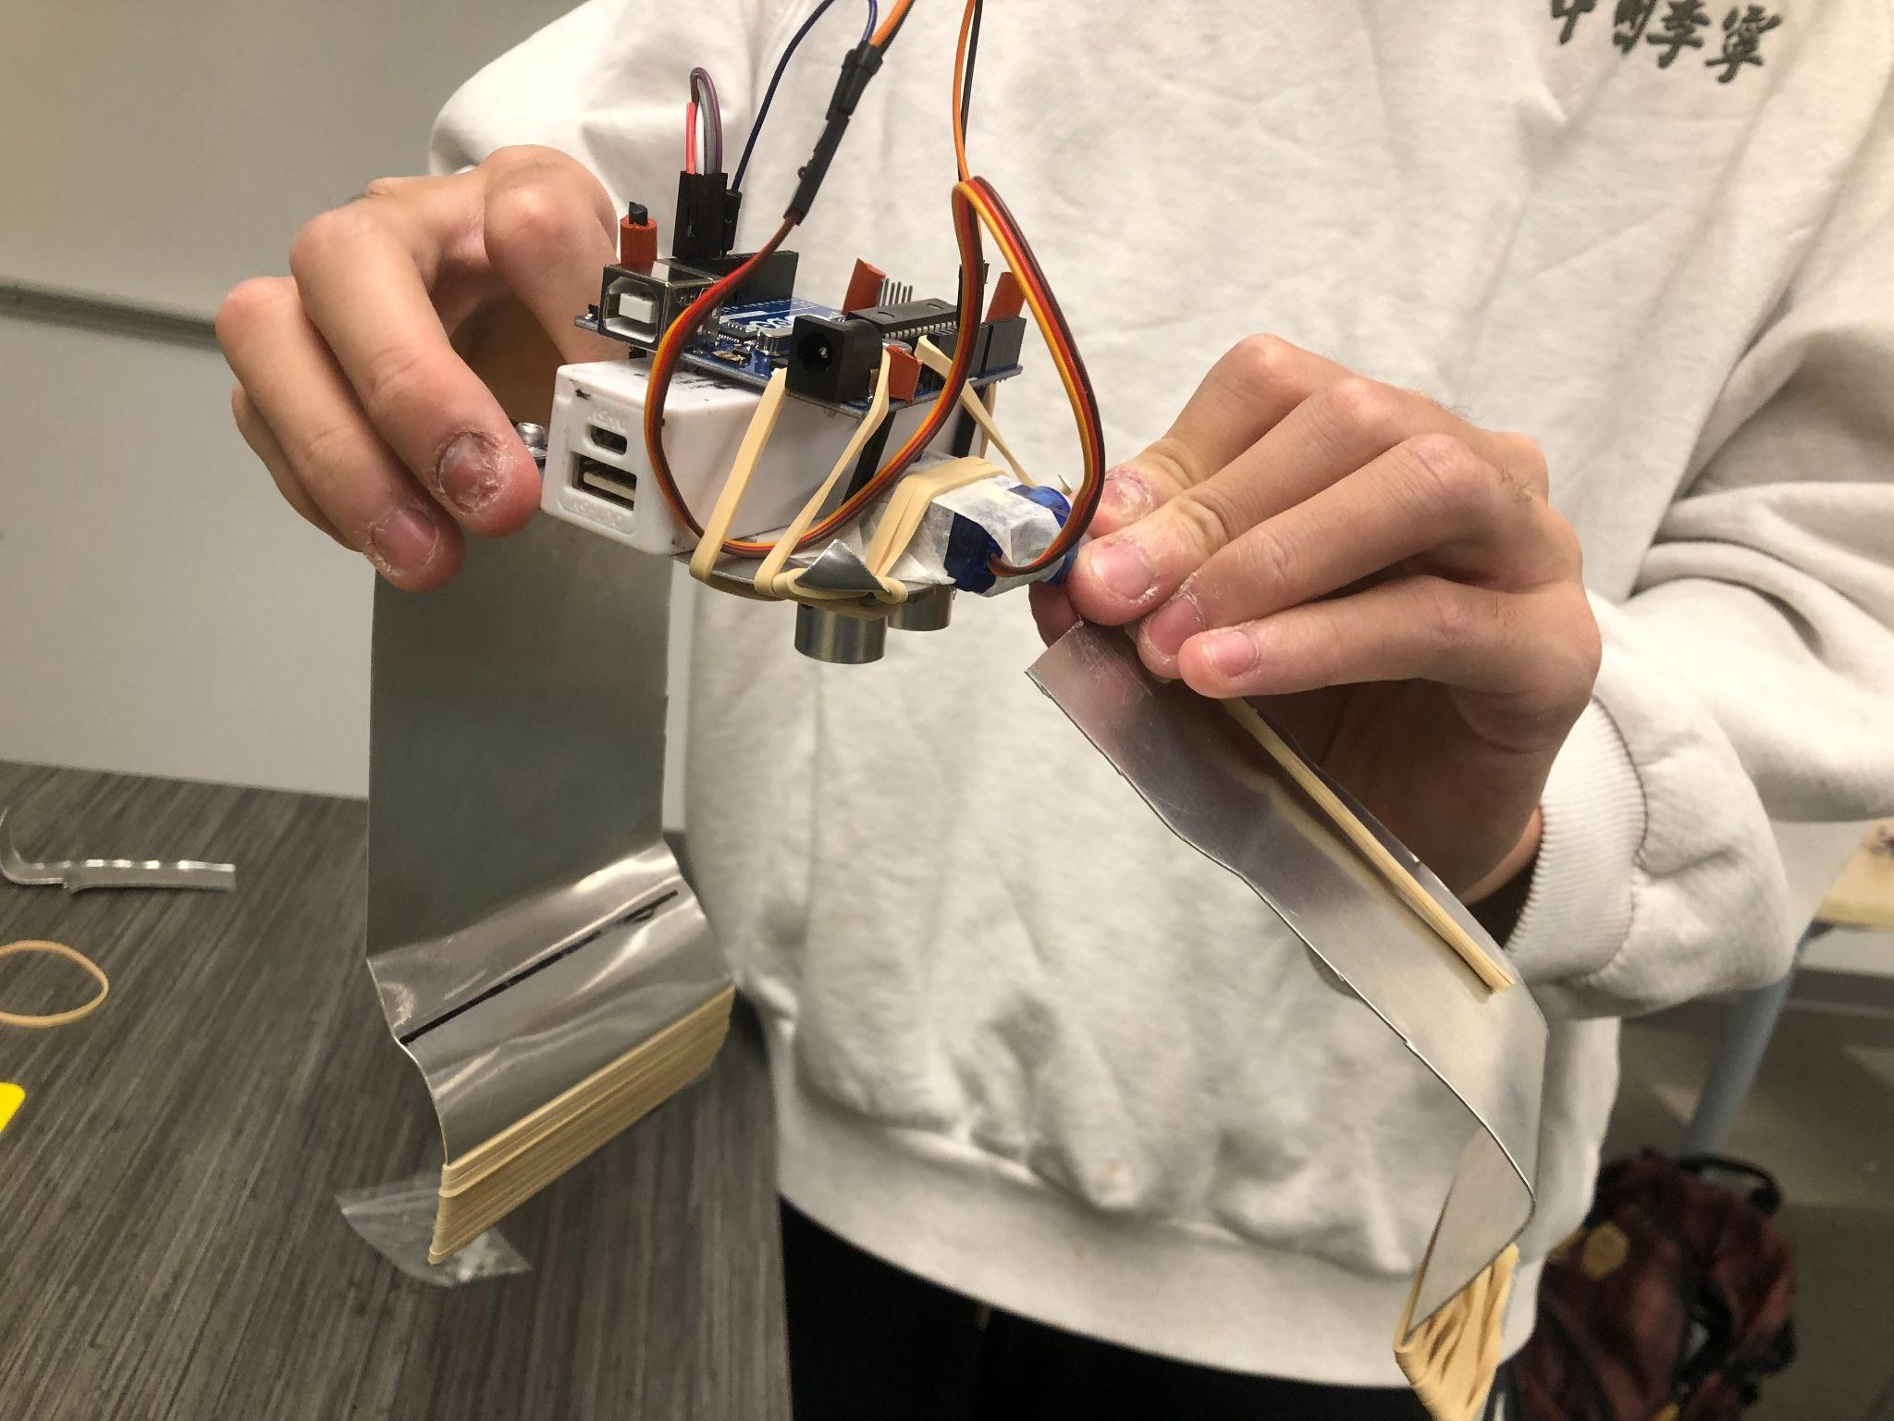
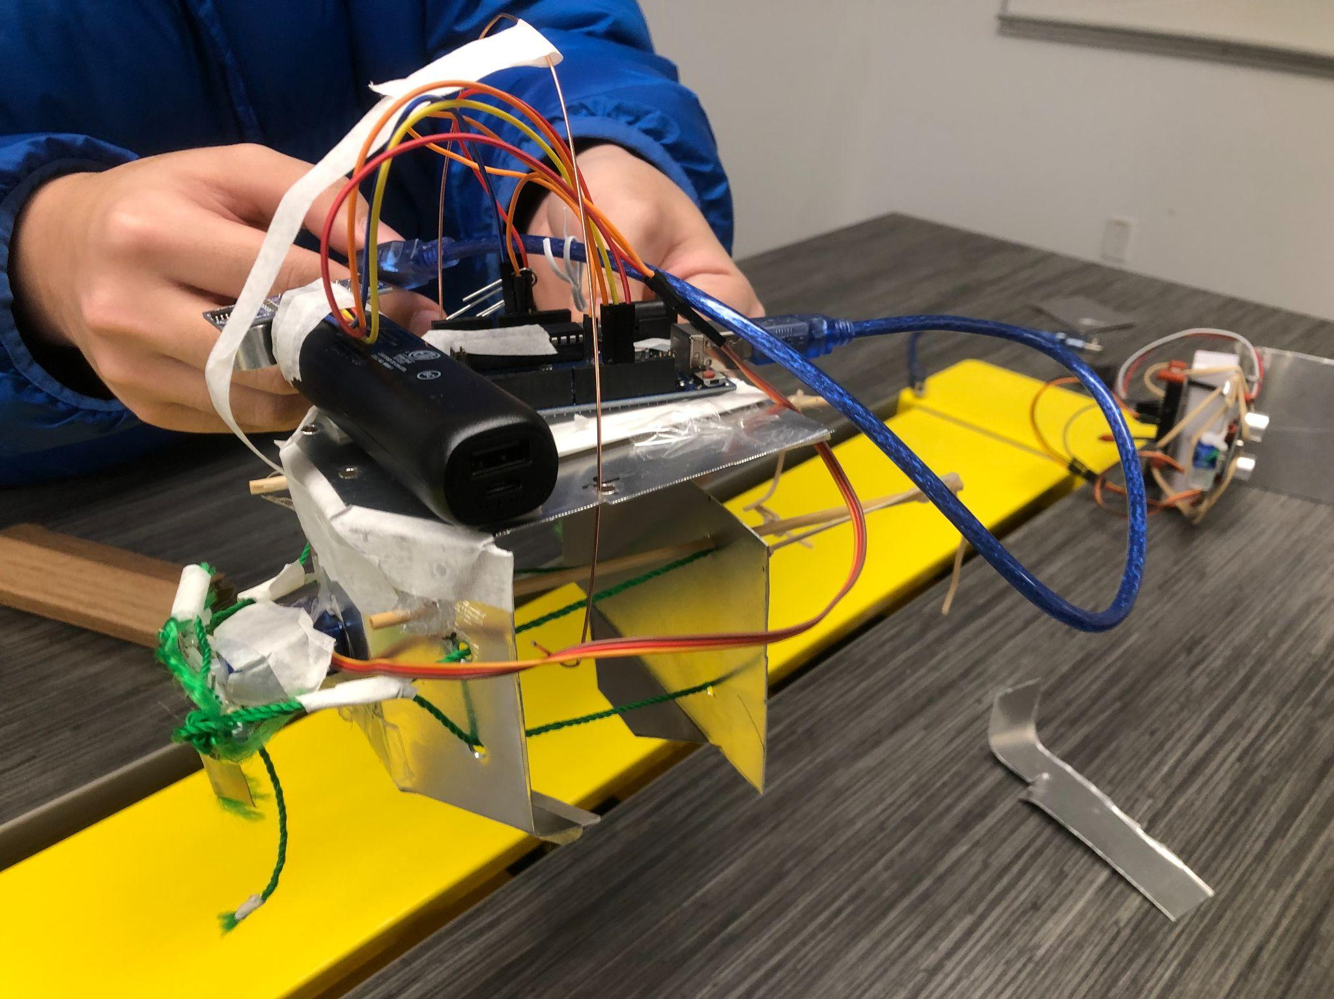
Module 5 E-Poster
B-7

Slide 2
Table of Contents - Summary of Our Presentation
Study and Clarify Problem
Introducing members, design challenge, competition overview, and design specifications.
Identify Most Promising Solution
Risk matrix and decisions that lead to final claw design.
01
01
03
Develop and Test Solution/Implement Solution
Display of engineering drawings and final claw(s).
Comparisons of early concepts to final designs.
Generate Potential Solutions
Showcasing the progression of design concepts, including concept sketches, prototypes, and strategic approach.
02
04

Slide 3
Introducing Team B-7
Tiger Zhou
Daniel Mok
Ahmad Abousaleh
Initials used: T.Z.
Initials used: D.M.
Initials used: A.A.
Yuding Jia
Helin Long
Andrew Wang
Initials used: Y.J.
Initials used: B.L.
Initials used: A.W.

Slide 4
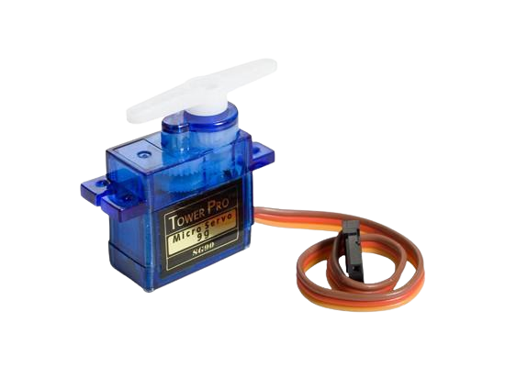
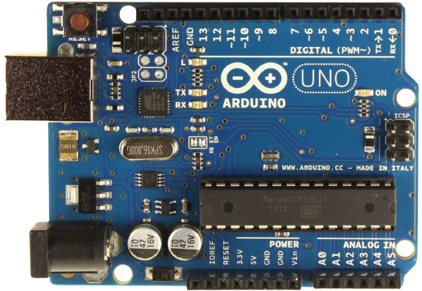
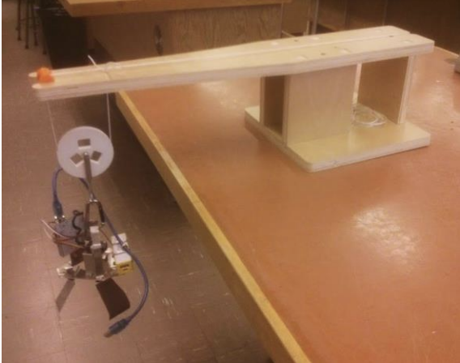
Design Challenge
Design and construct an object retrieval claw using an Arduino and servo motor
Opening/closing of claw must be fully automatic
Movement of the claw is done by team member via crane pulley system

Slide 5
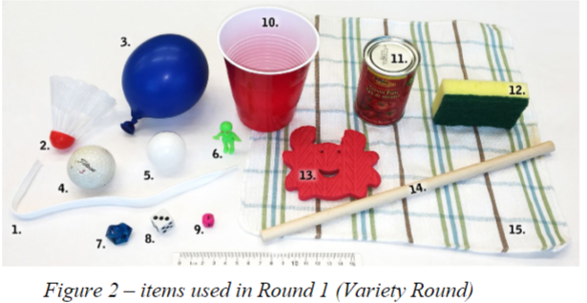
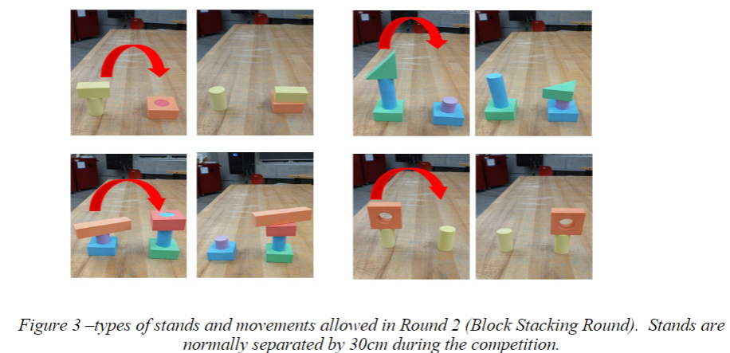
Overview of Competition Rounds
Round 1: Variety Round
Round 2: Block Stacking
Round 3: Co-op Relay

Slide 6
Variety Round
Overview
Objective: transport as many objects as possible into a bin; objects shown in image
Parameters: time; 4 minutes, 1 point/item

Slide 7
Block Stacking
Overview
Objective: successfully transport and stack foam blocks
Parameters: time; 4 minutes, points vary with difficulty of stack

Slide 8
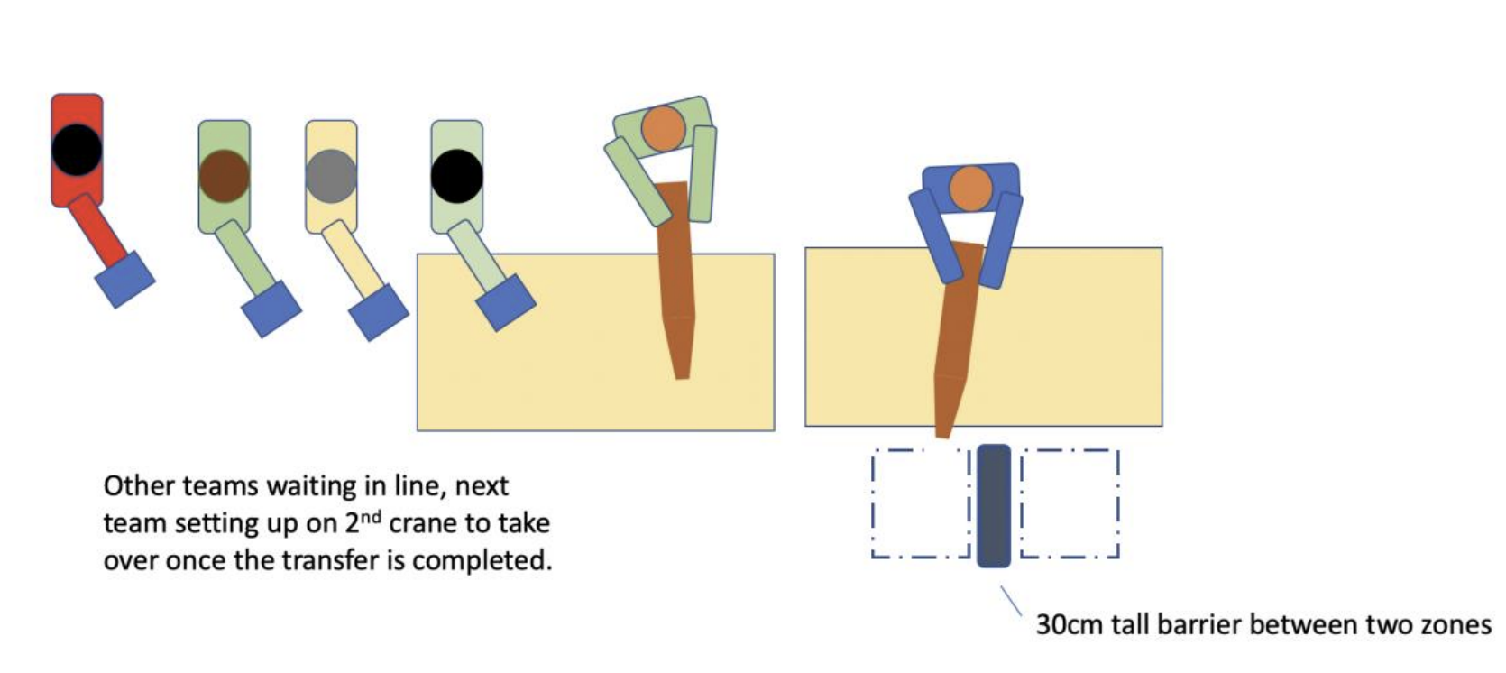
Cooperative Round
Overview
Objective: complete relay race of the transportation of 1 object with all teams in the studio
Parameters: completion of course; time is converted into a score

Slide 9
Team Strategy
Since each event requires different attributes for the claw; therefore, we decided to attempt two claw designs…
Requires precision, accuracy, and stability. The claw needs to be able to softly “pinch” the foam blocks
Requires strength, and a reliable containment system. The claw needs to bear objects of varying weights and dimensions.

Slide 10

We took a strategic risk through our approach of deciding to build 2 claws…
Benefits:
Backup claw incase one malfunctions
Able to optimize our designs for the respective competition rounds
Less fixation
Drawbacks:
More time needed to design and construct claws
More materials needed; higher financial investment requirements
Team effort is diverged between two designs

Slide 11
Generate Possible Solutions
This section introduces C-Sketch concepts and prototypes
We start by looking at the team’s C-Sketches…

Slide 12
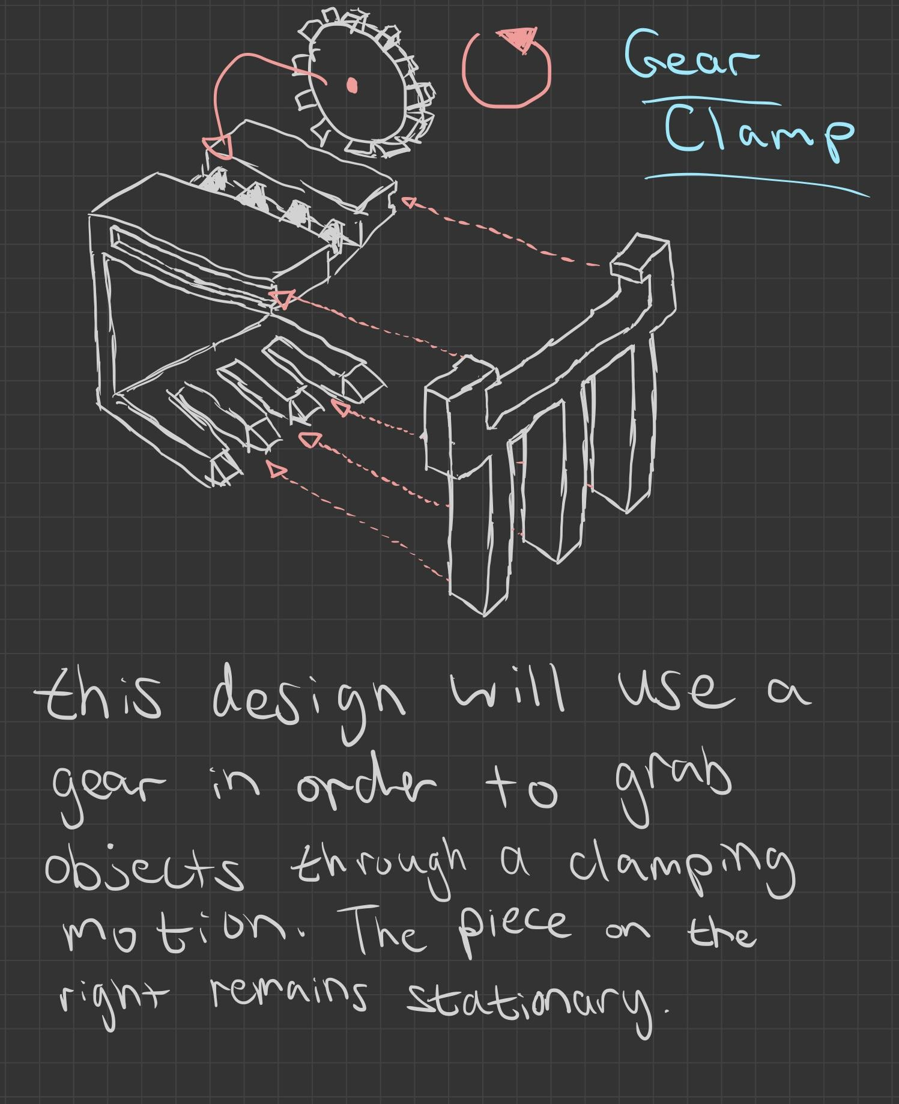
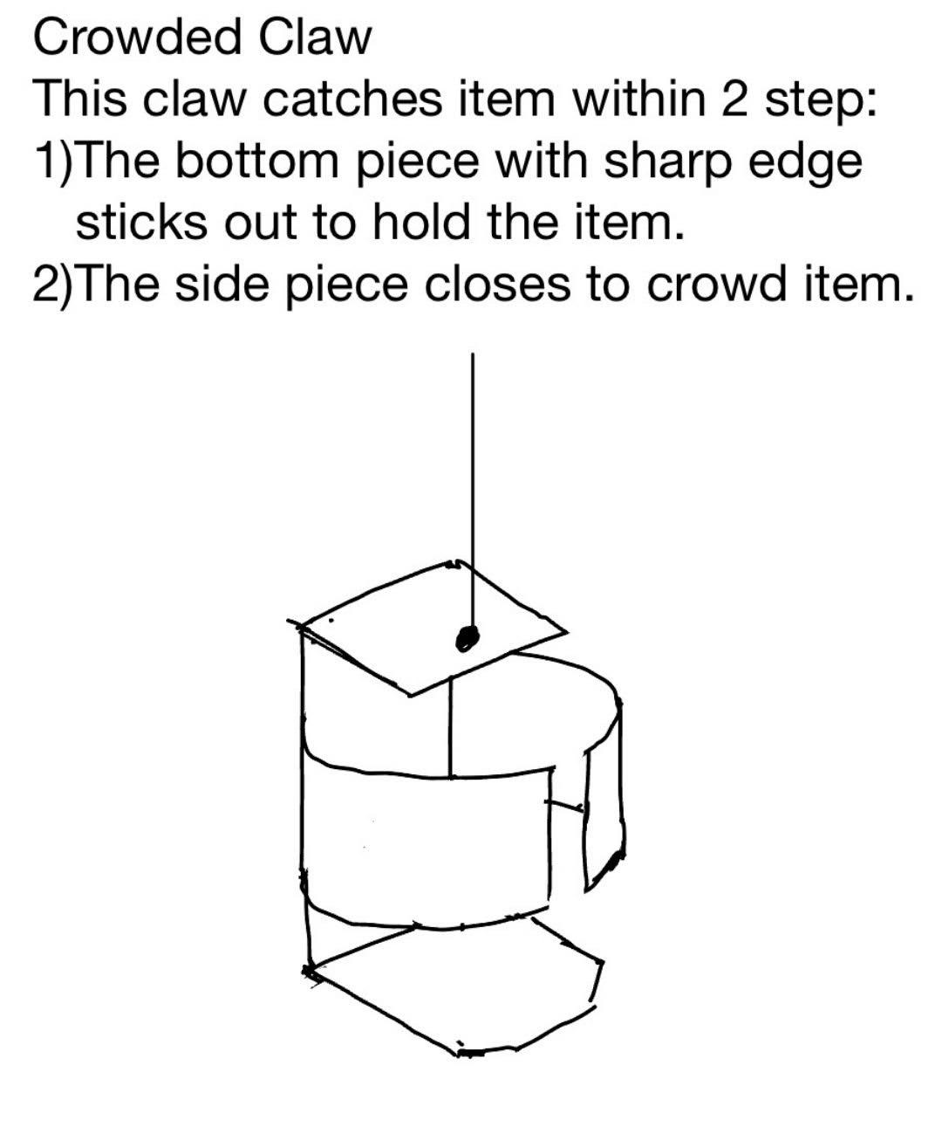
Gear Clamp – T.Z.
Crowded Claw – Y.J.

Slide 13
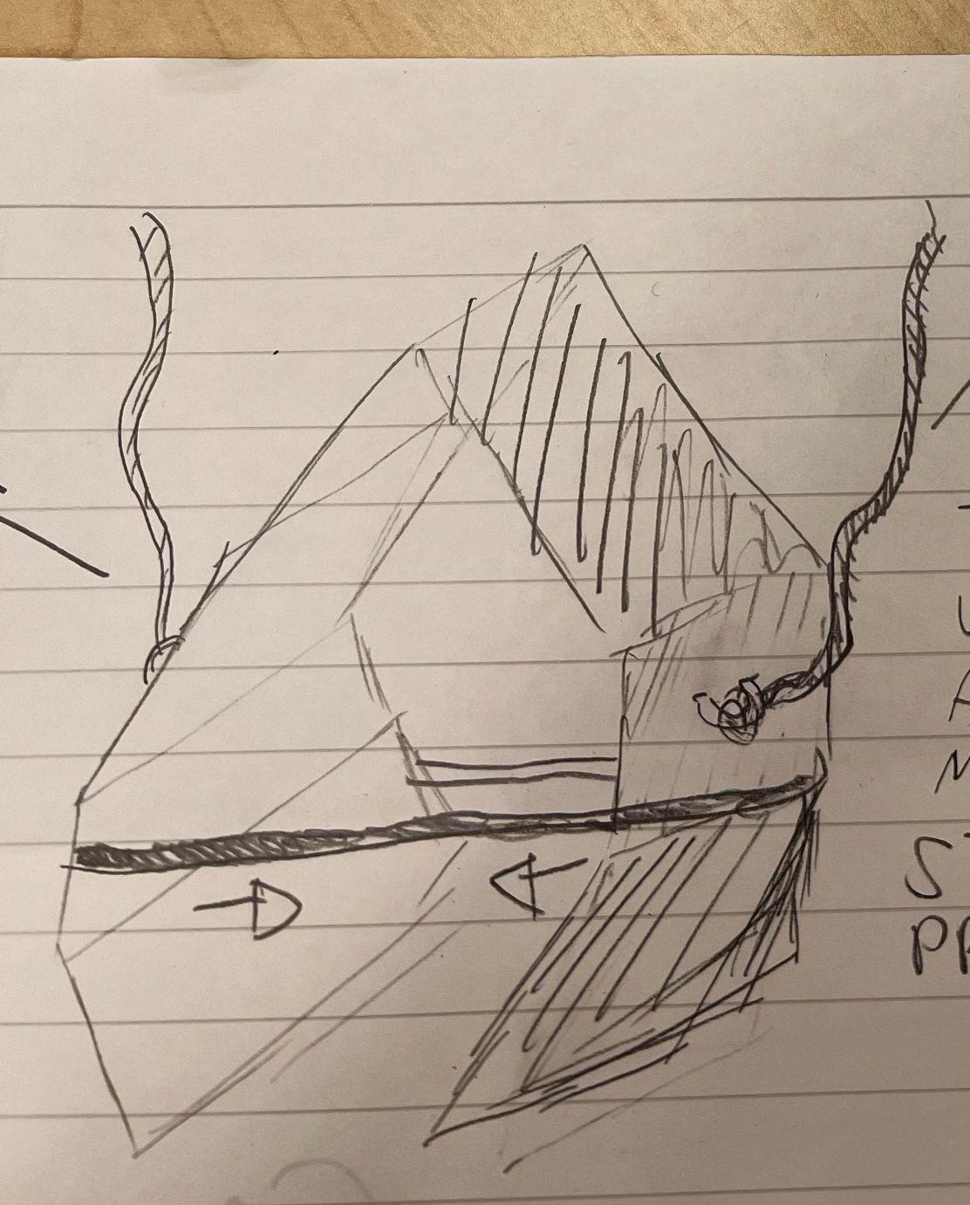
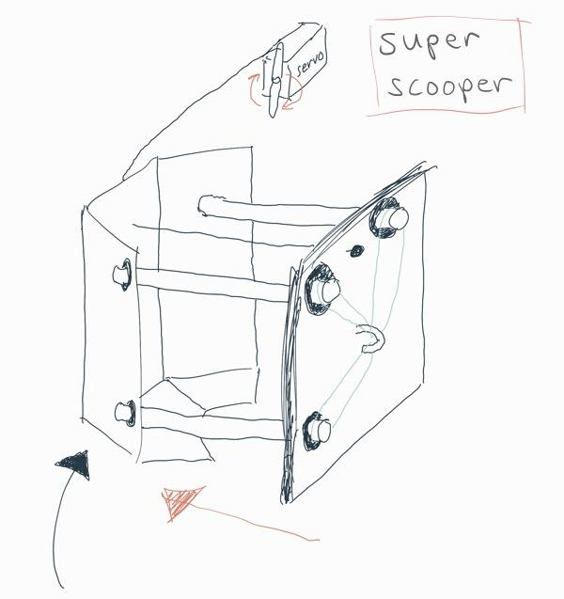
Thread Clone – D.M.
Super Scooper – A.A.

Slide 14
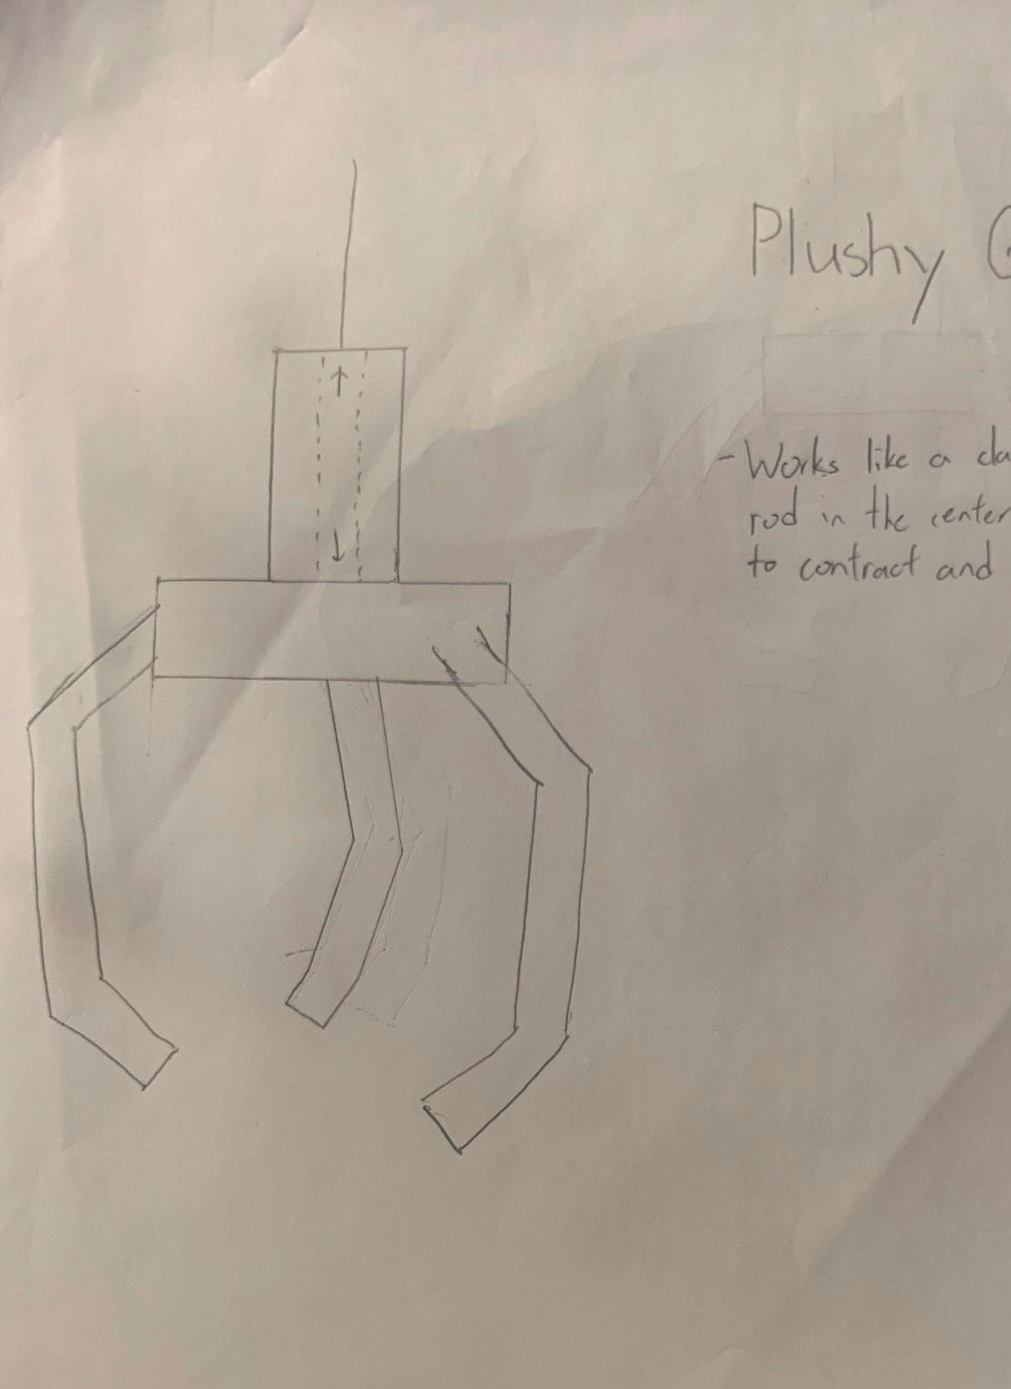
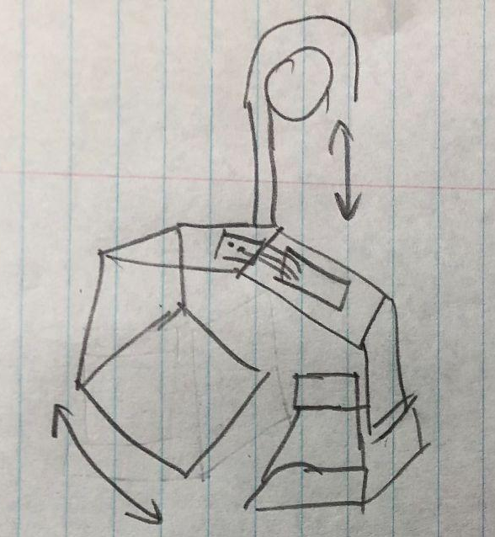
Plushy Grabber – A.W.
Pincher – D.M.

Slide 15
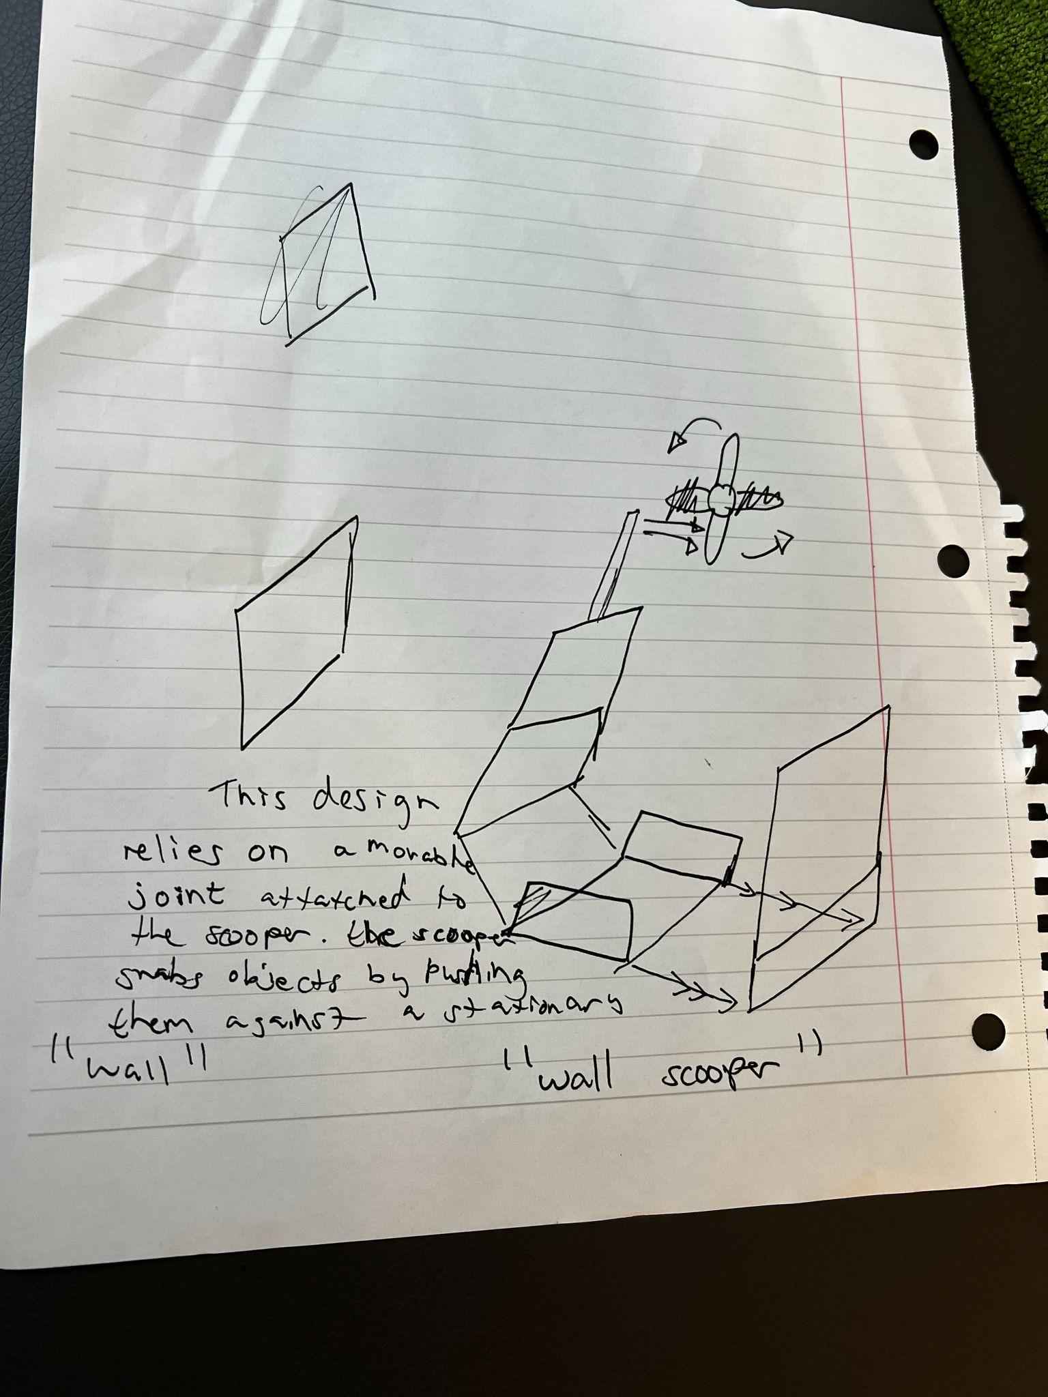
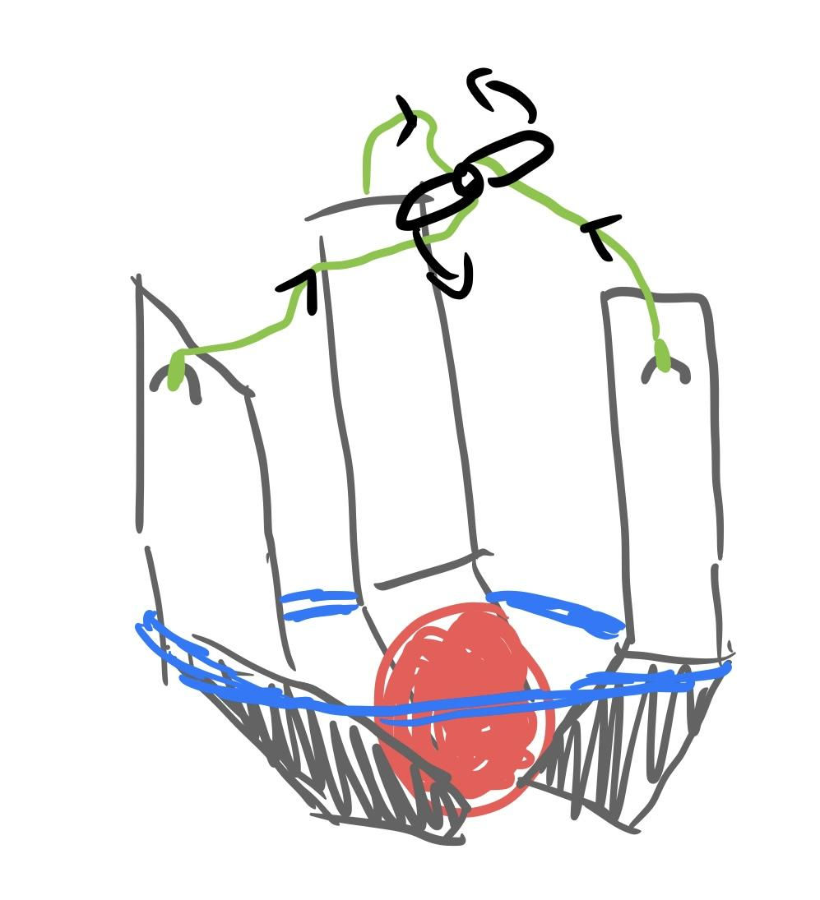
Wall Scooper – B.L.
TriClaw – T.Z.

Slide 16
We Then Pursued Some of These Concepts and Created Prototypes…

Slide 17
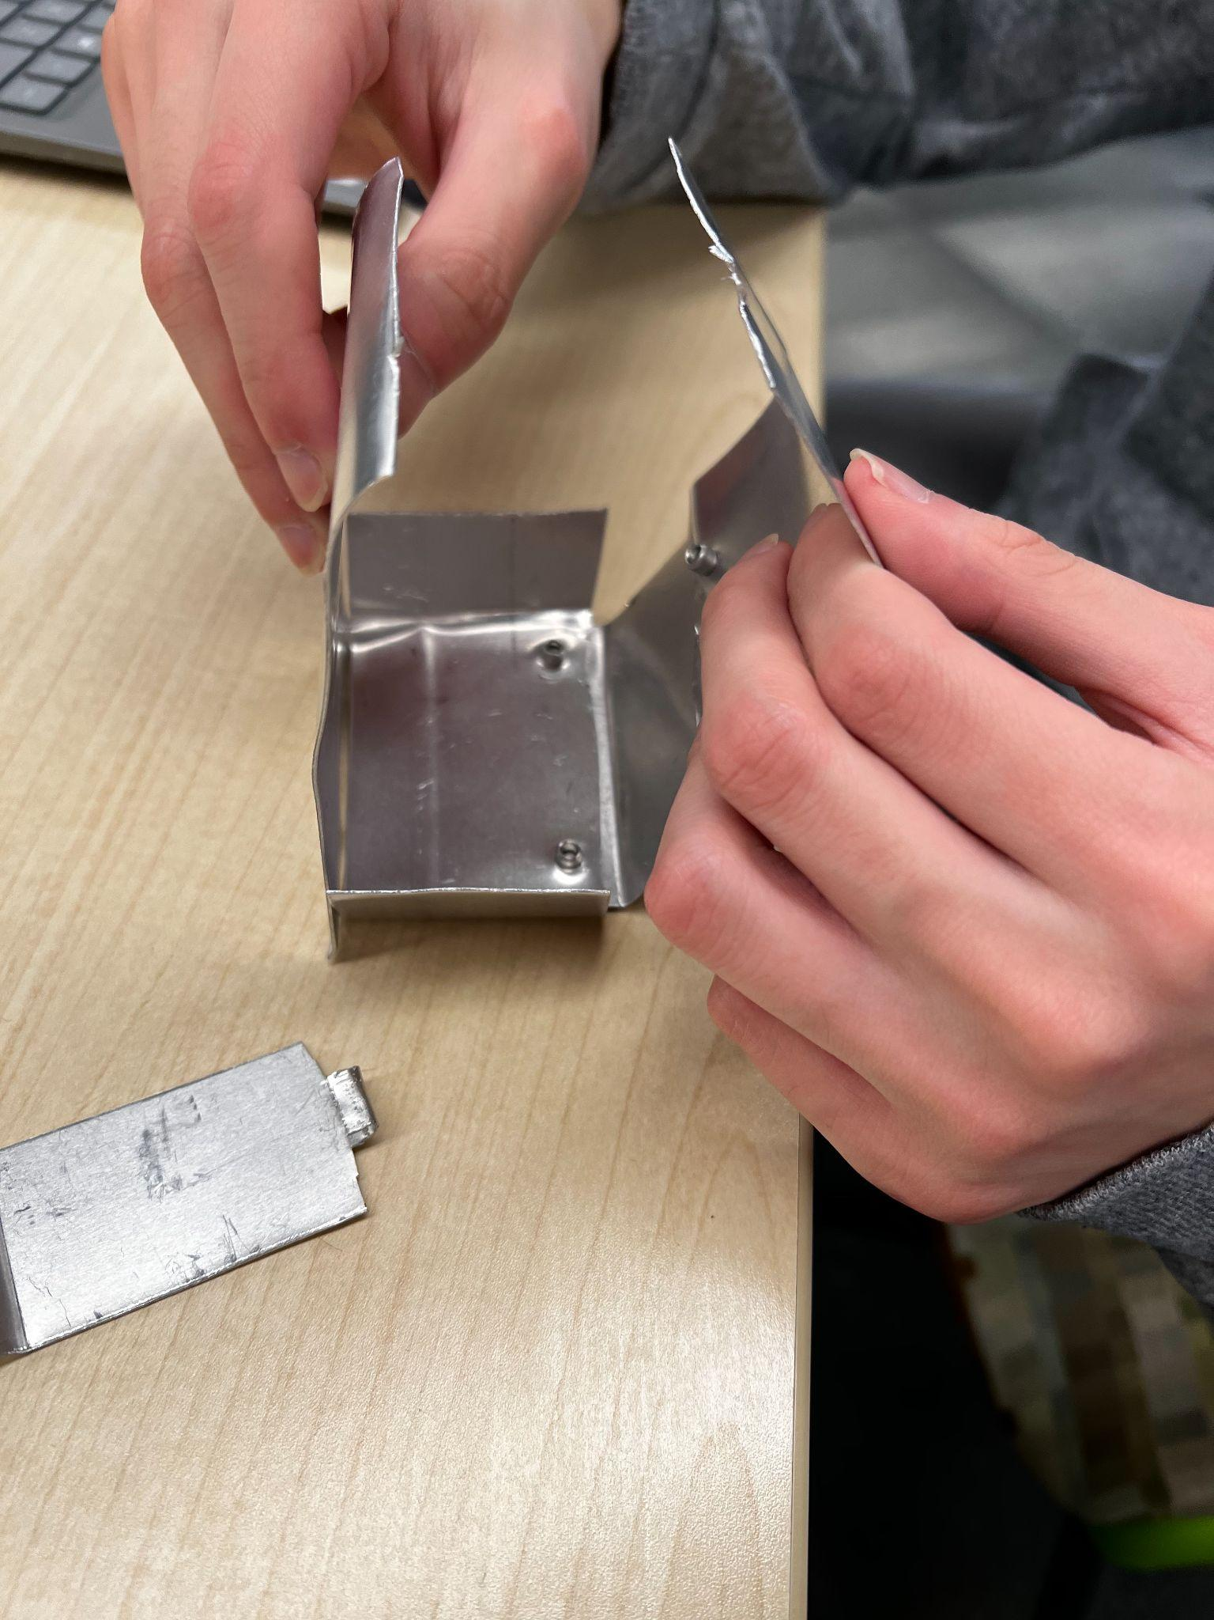
Wall Scooper
Prototyped by T.Z.

Slide 18
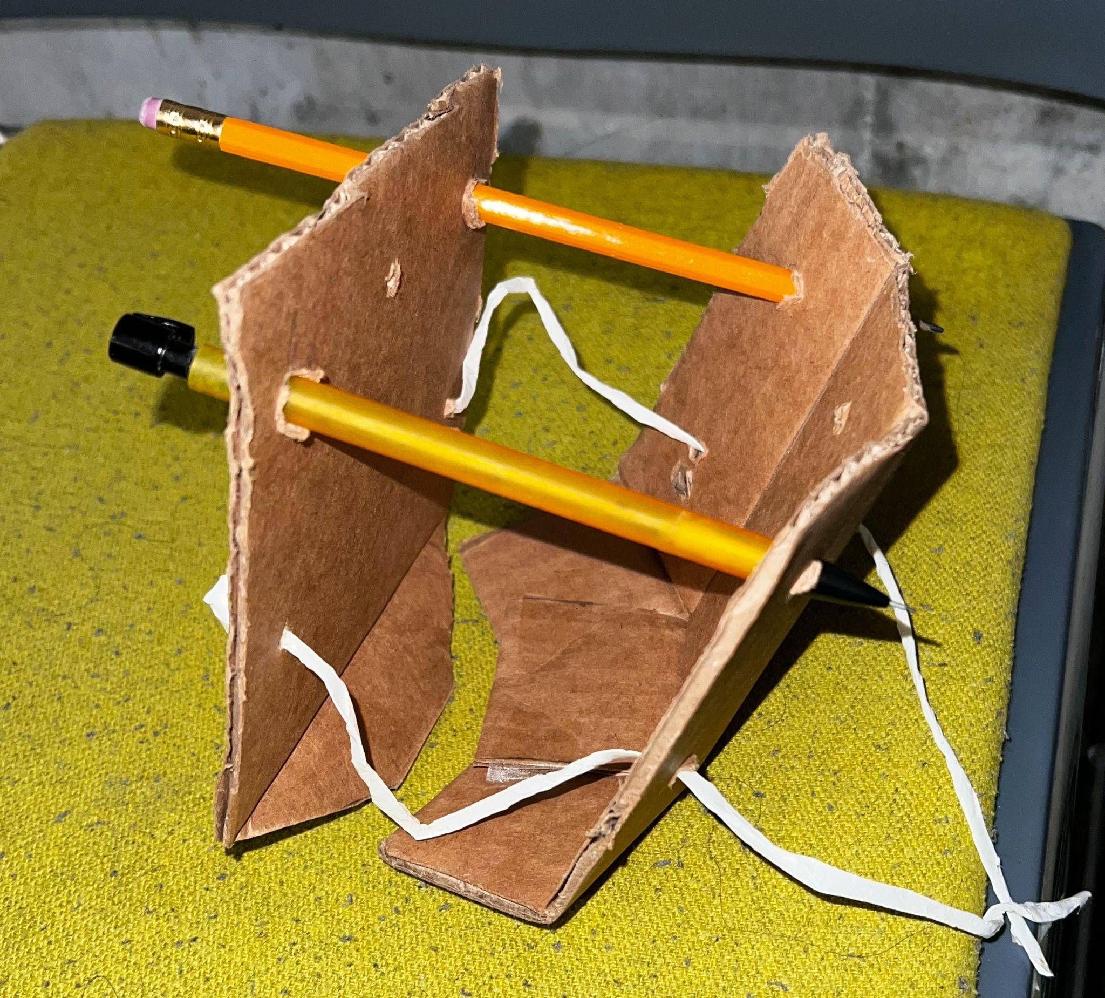
Super Scooper
Prototyped By A.A.

Slide 19
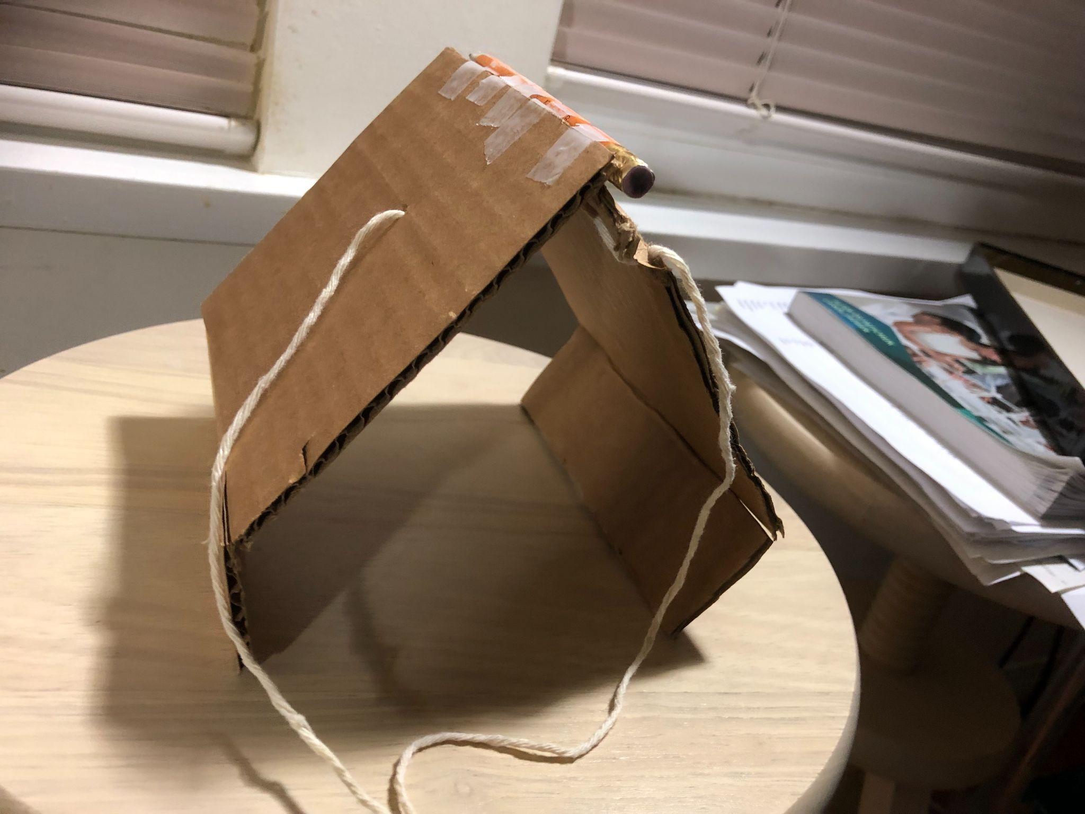
Threaded Clone
Prototyped By D.M.

Slide 20
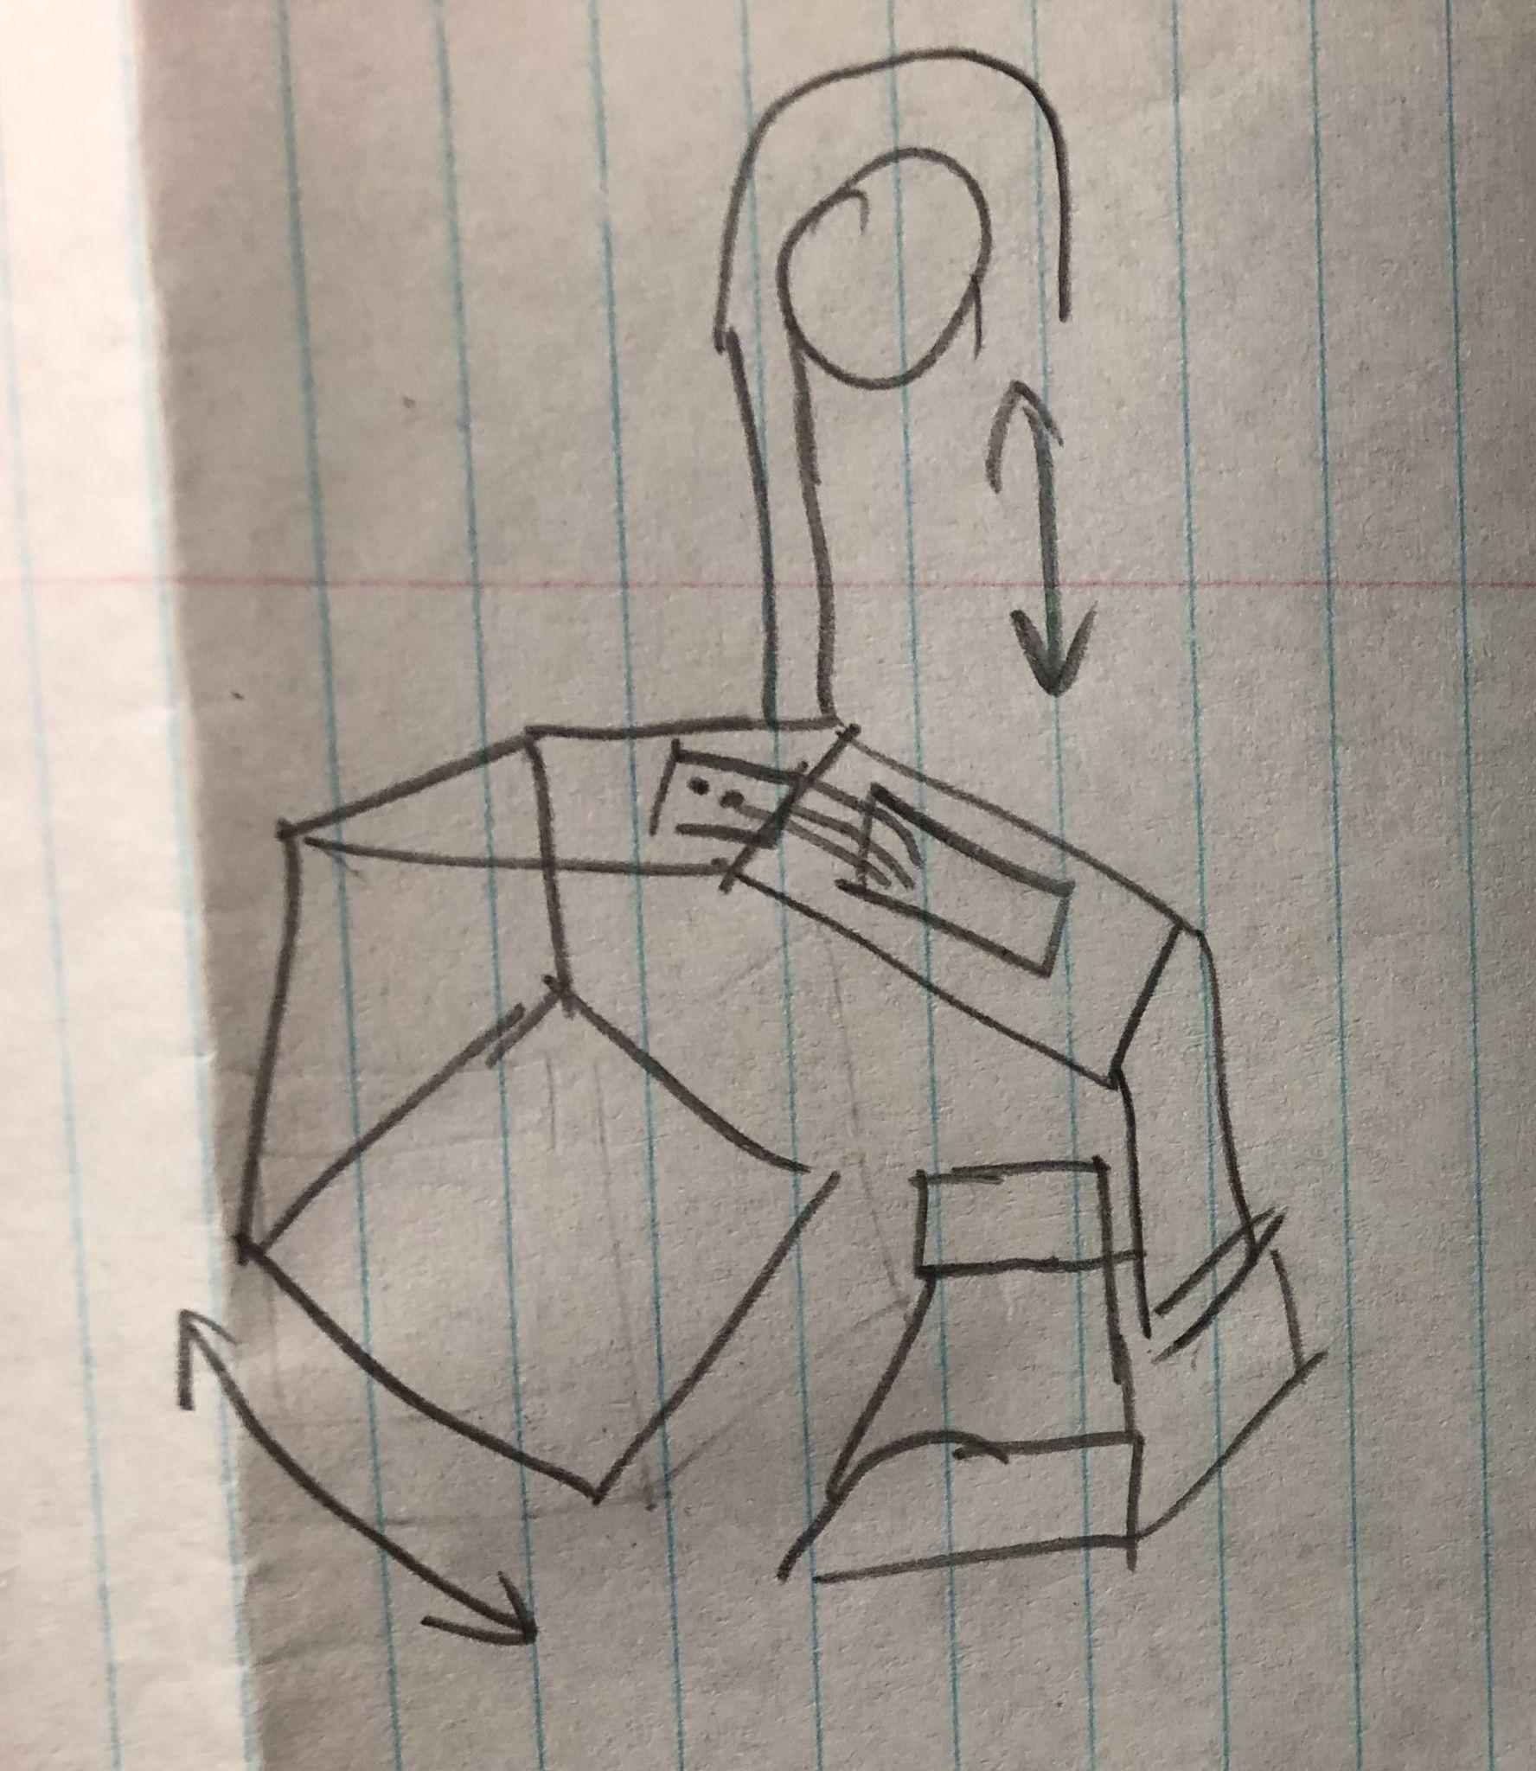
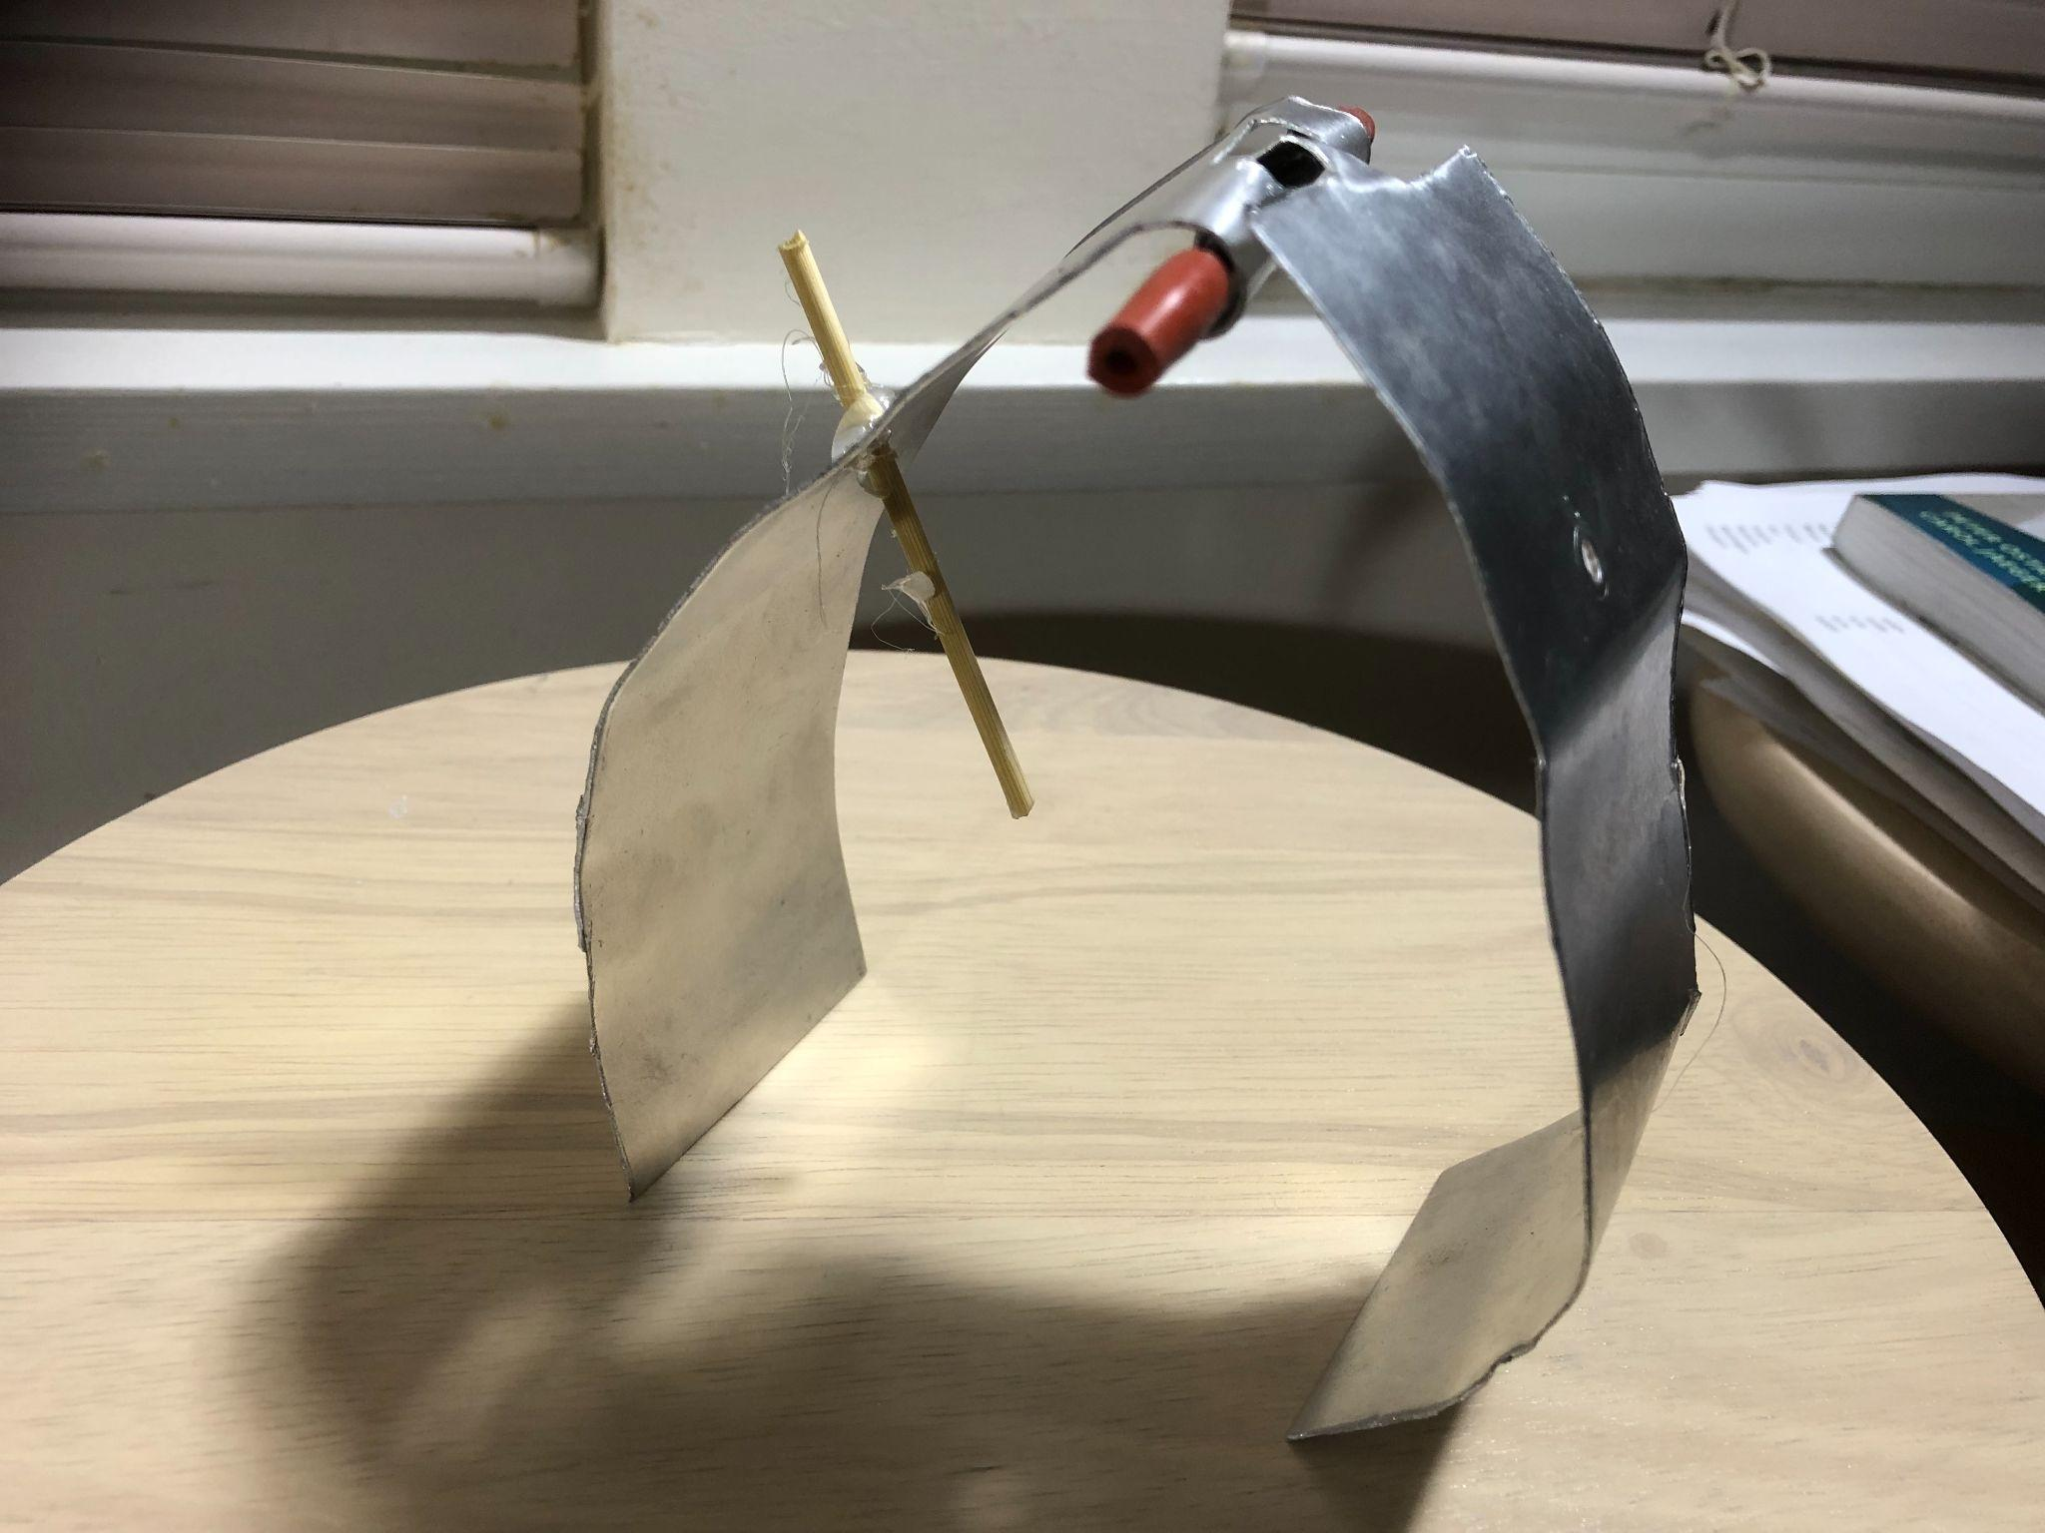
Pincher
Prototyped By A.W.

Slide 21
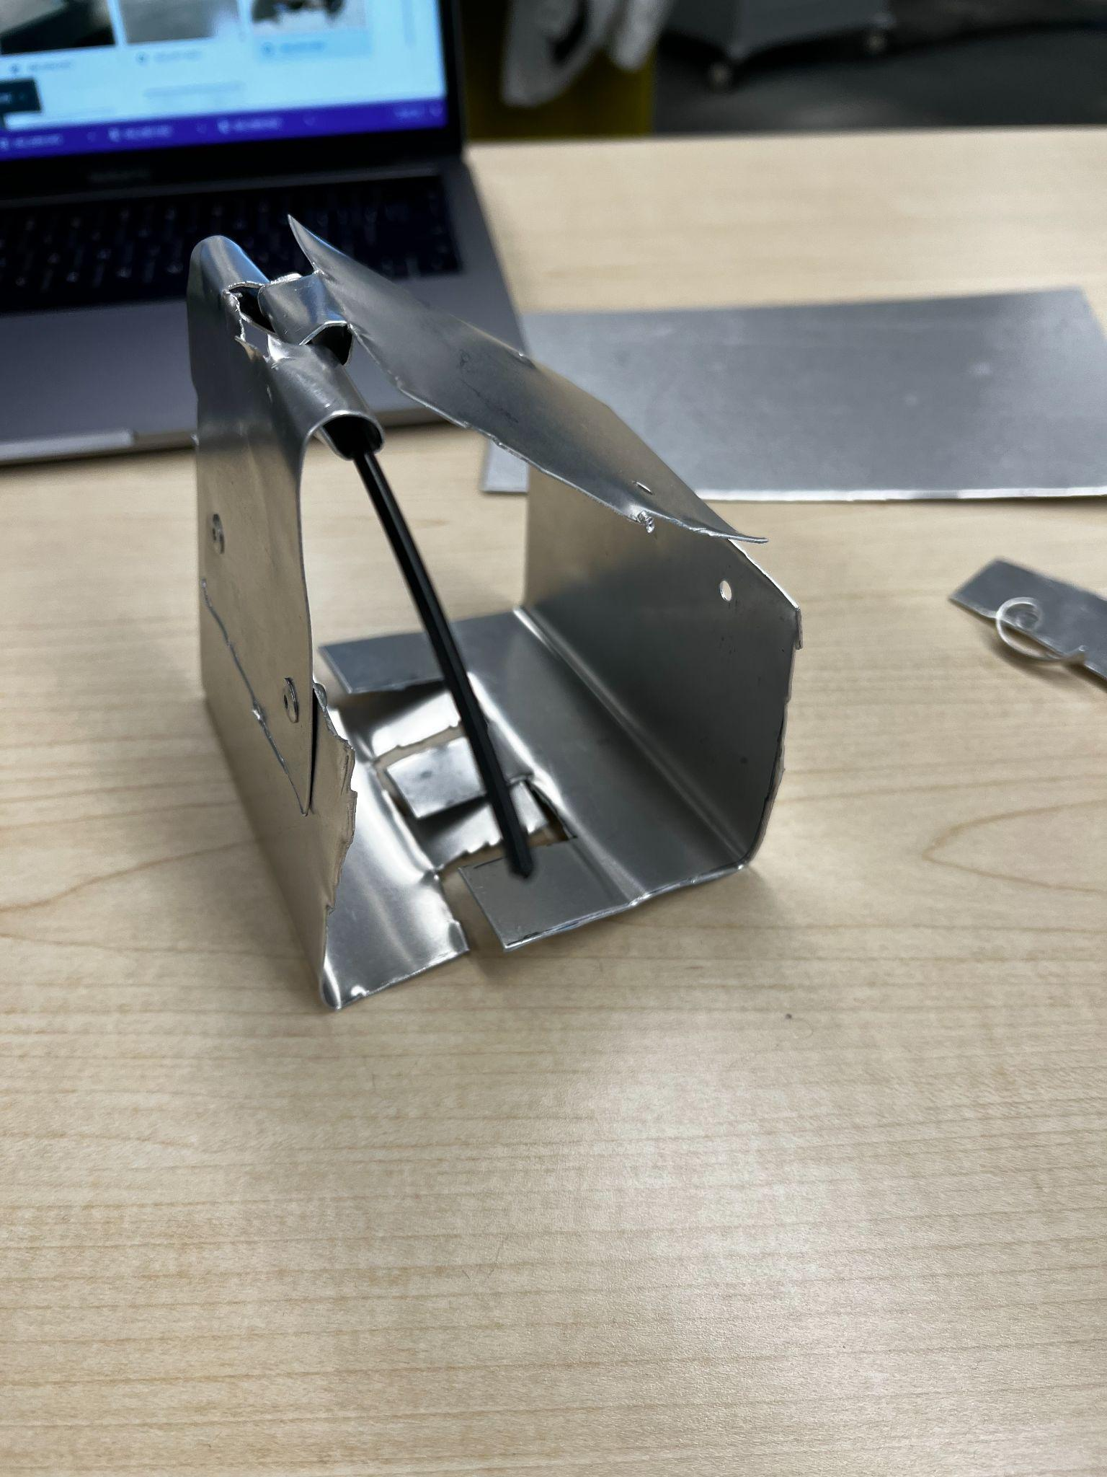
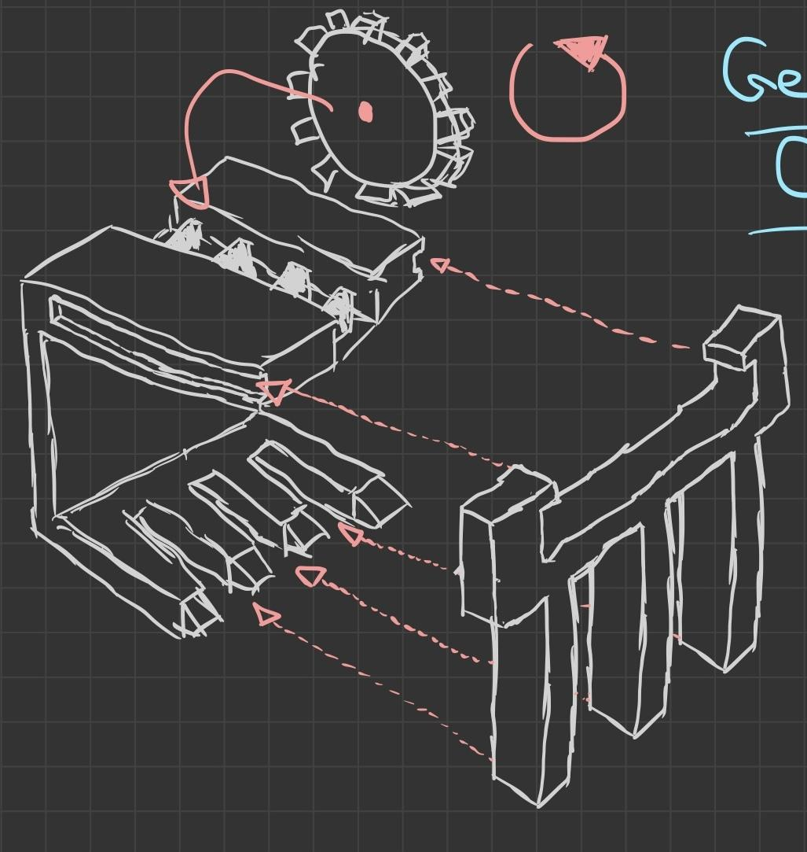
Gear Clamp
Prototyped By B.L.

Slide 22
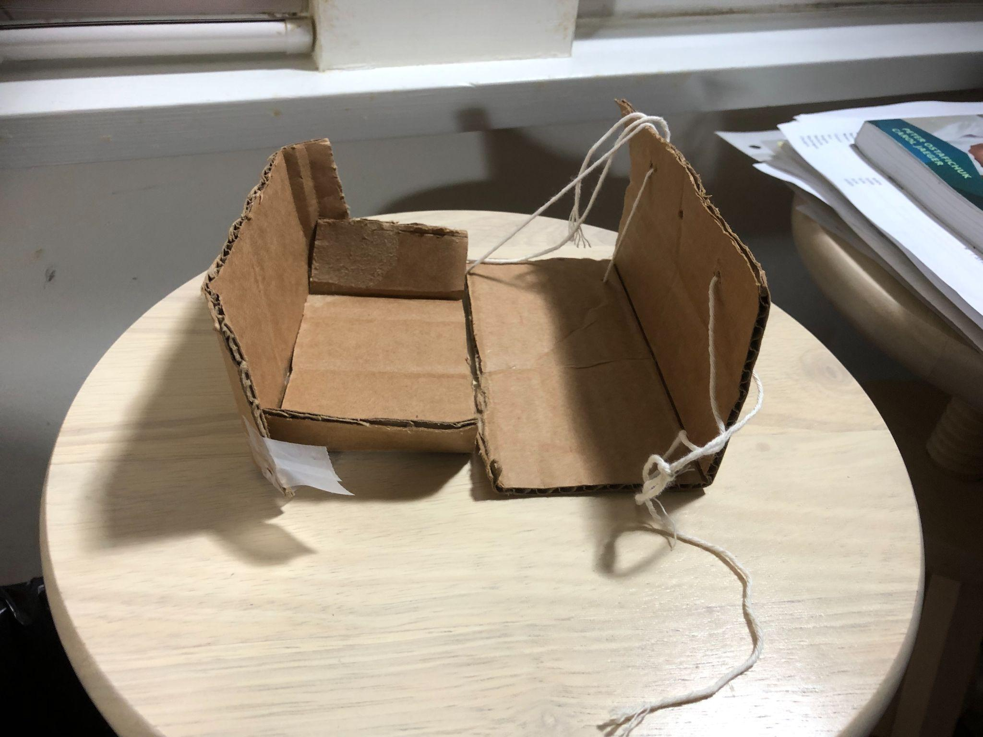
Wall Scooper; 2nd iteration
Prototyped by Y.J.

Slide 23
Identify Promising Solutions

Slide 24
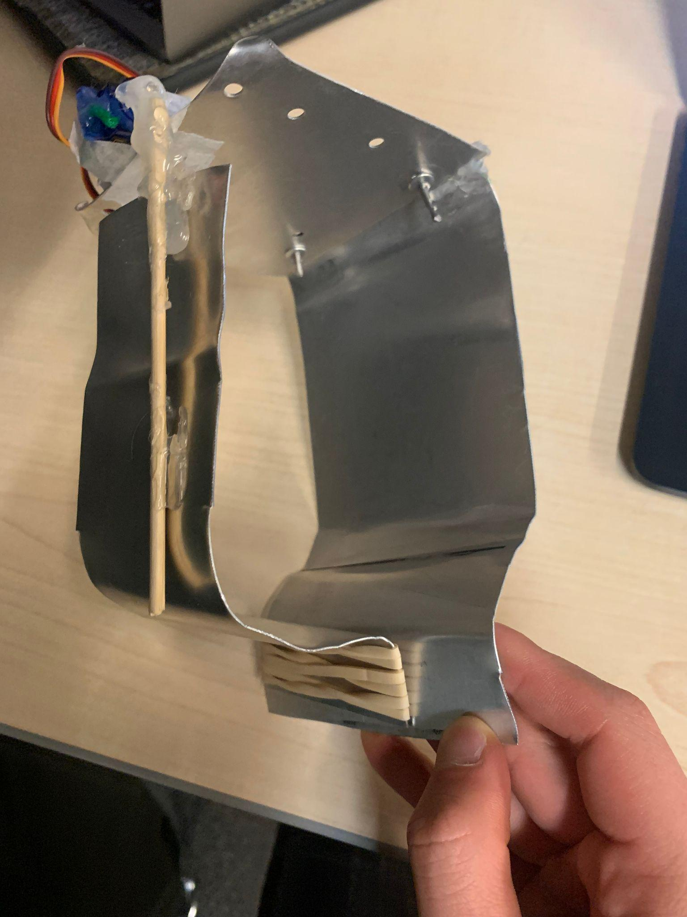
Screening
Ranking
Our ranking process is conducted in a voting scheme. We decided to advance the top 3 designs into scoring.
1. Super Scooper 2. Pincher
3. Thread Clone
The requirements were:
Create autonomous retrieval system
Using permitted materials only
5 designs moved forward to ranking

Slide 25
Scoring Criteria
The prototypes are scored based on the criteria taken from design specifications:
Able to pick up variety of objects
Weight Capacity
# of objects picked up within 4 minutes
Pick up and drop off speed
Accuracy/error margin

Slide 26
Scoring Results & Analysis
Applying our rubric, the final scores out of 10 are:
The Super Scooper 5.55
The Pincher 5.35
The Thread Clone 4.15
Analysis
The Super Scooper and The Pincher have similar scores, but are both greater than Thread Clone. We chose to move forward with Super Scooper and Pincher due to their effectiveness in their respective categories. The Super Scooper, could pick up heavy objects with ease and was capable of holding things of different shapes and sizes. The Pincher could stack objects consistently and keep them at the same orientation.

Slide 27
Develop and Test/Implement Solutions

Slide 28
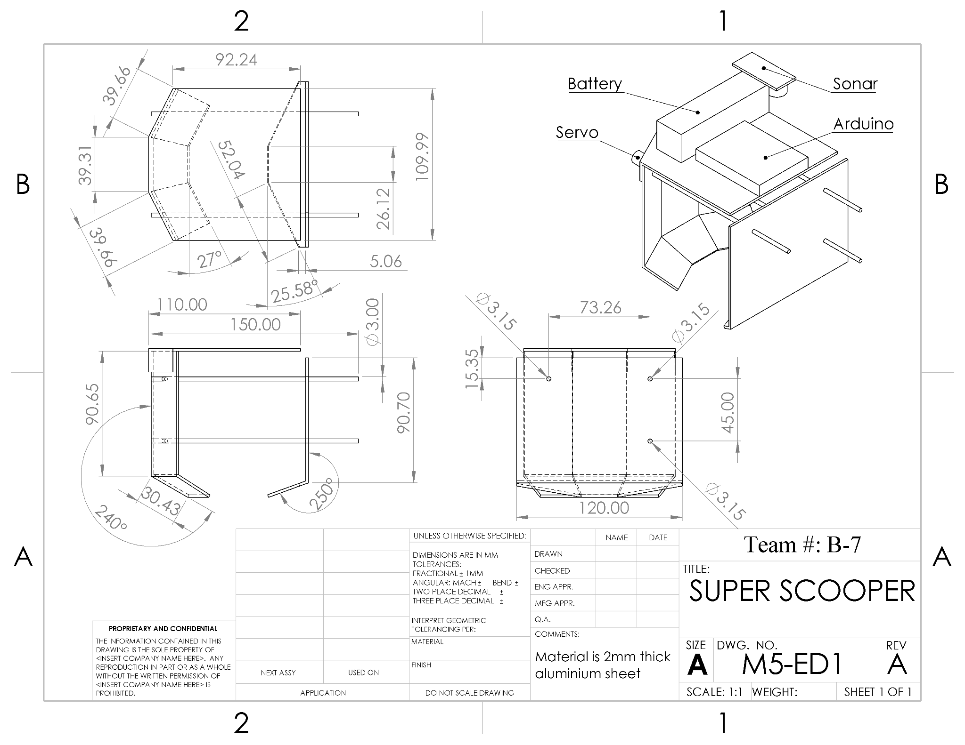
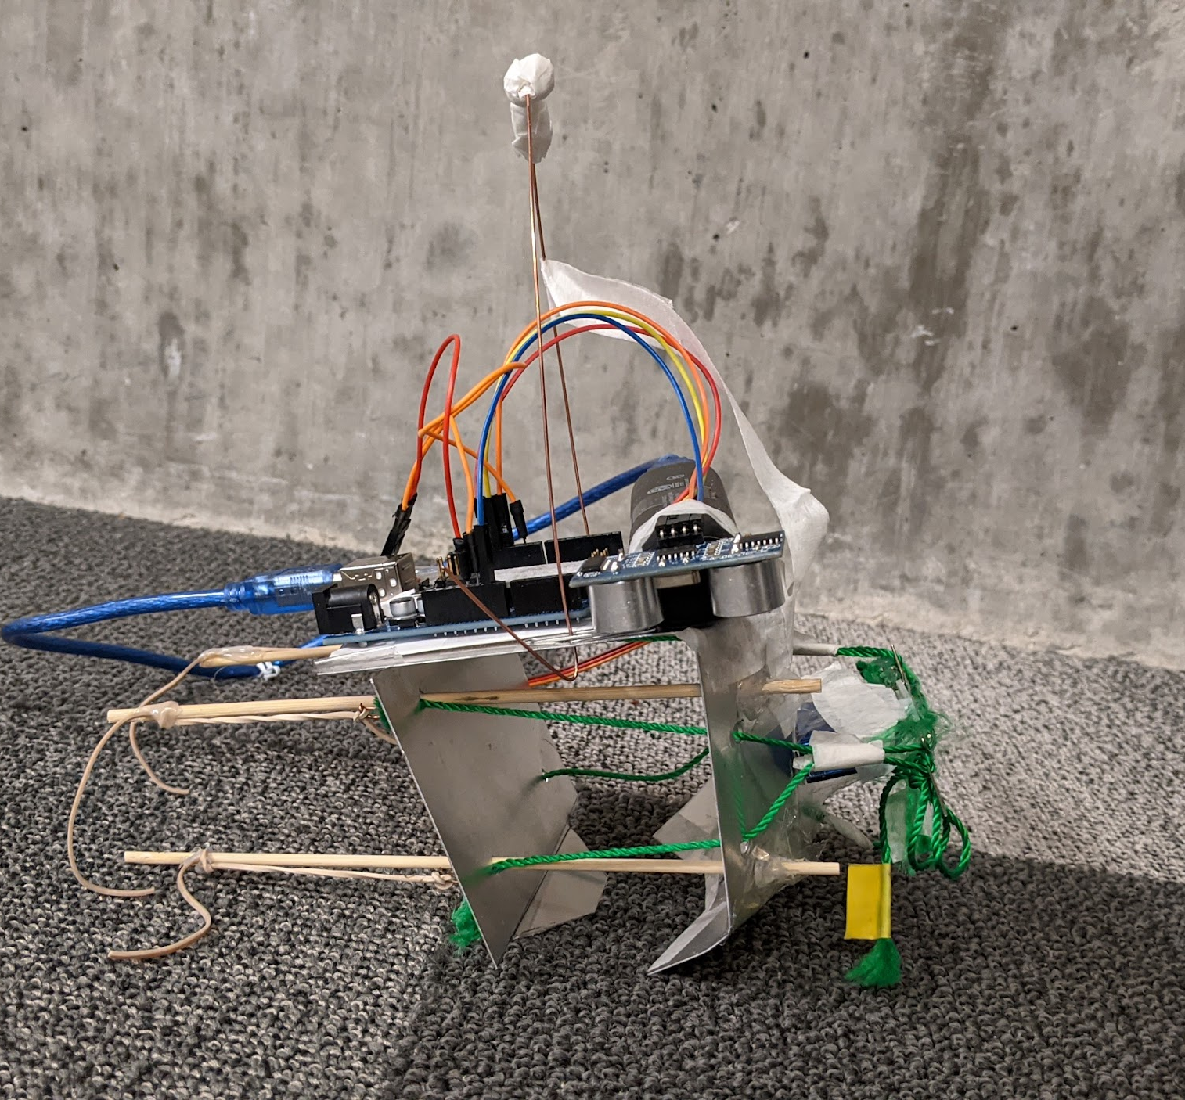
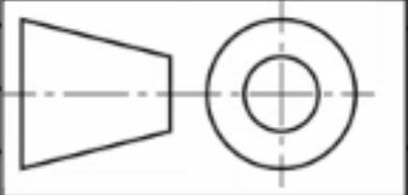
Super Scooper
Orthographic Drawing
Super Scooper Final Design

Slide 29
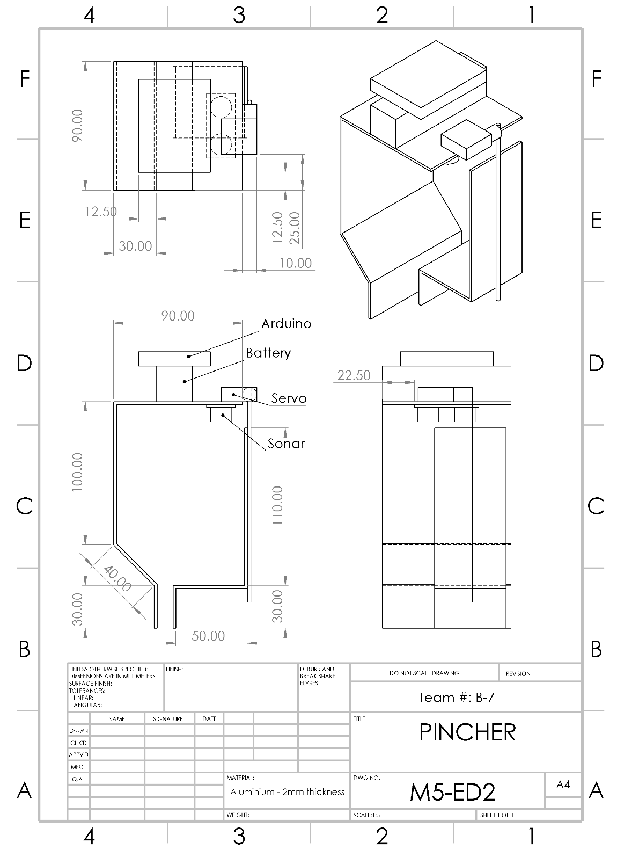
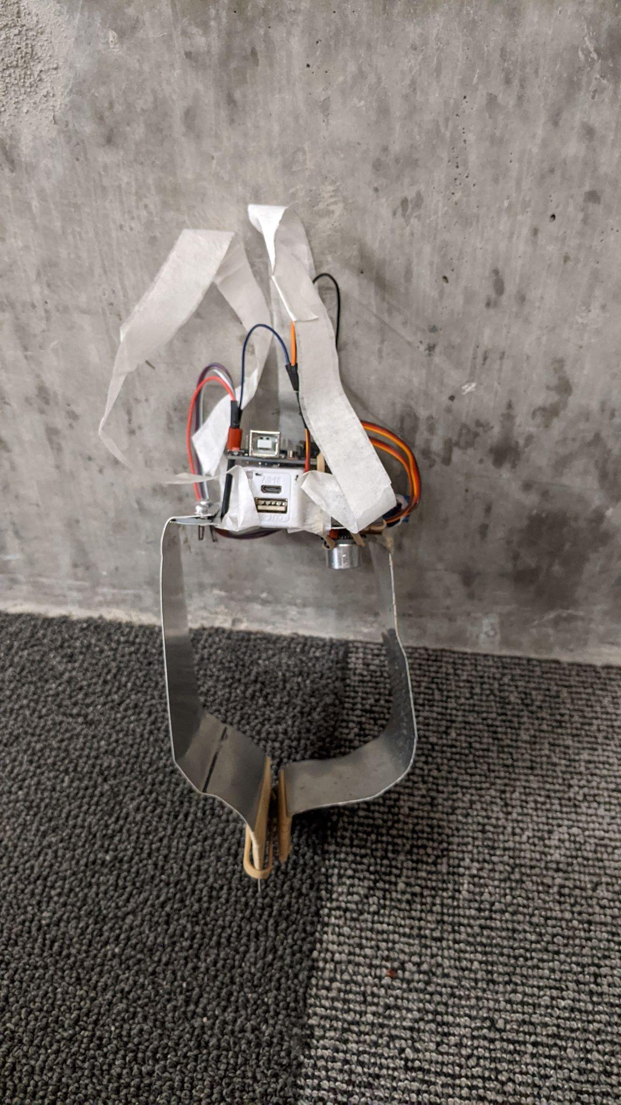
Pincher Orthographic Drawing
Pincher Final Design

Slide 30
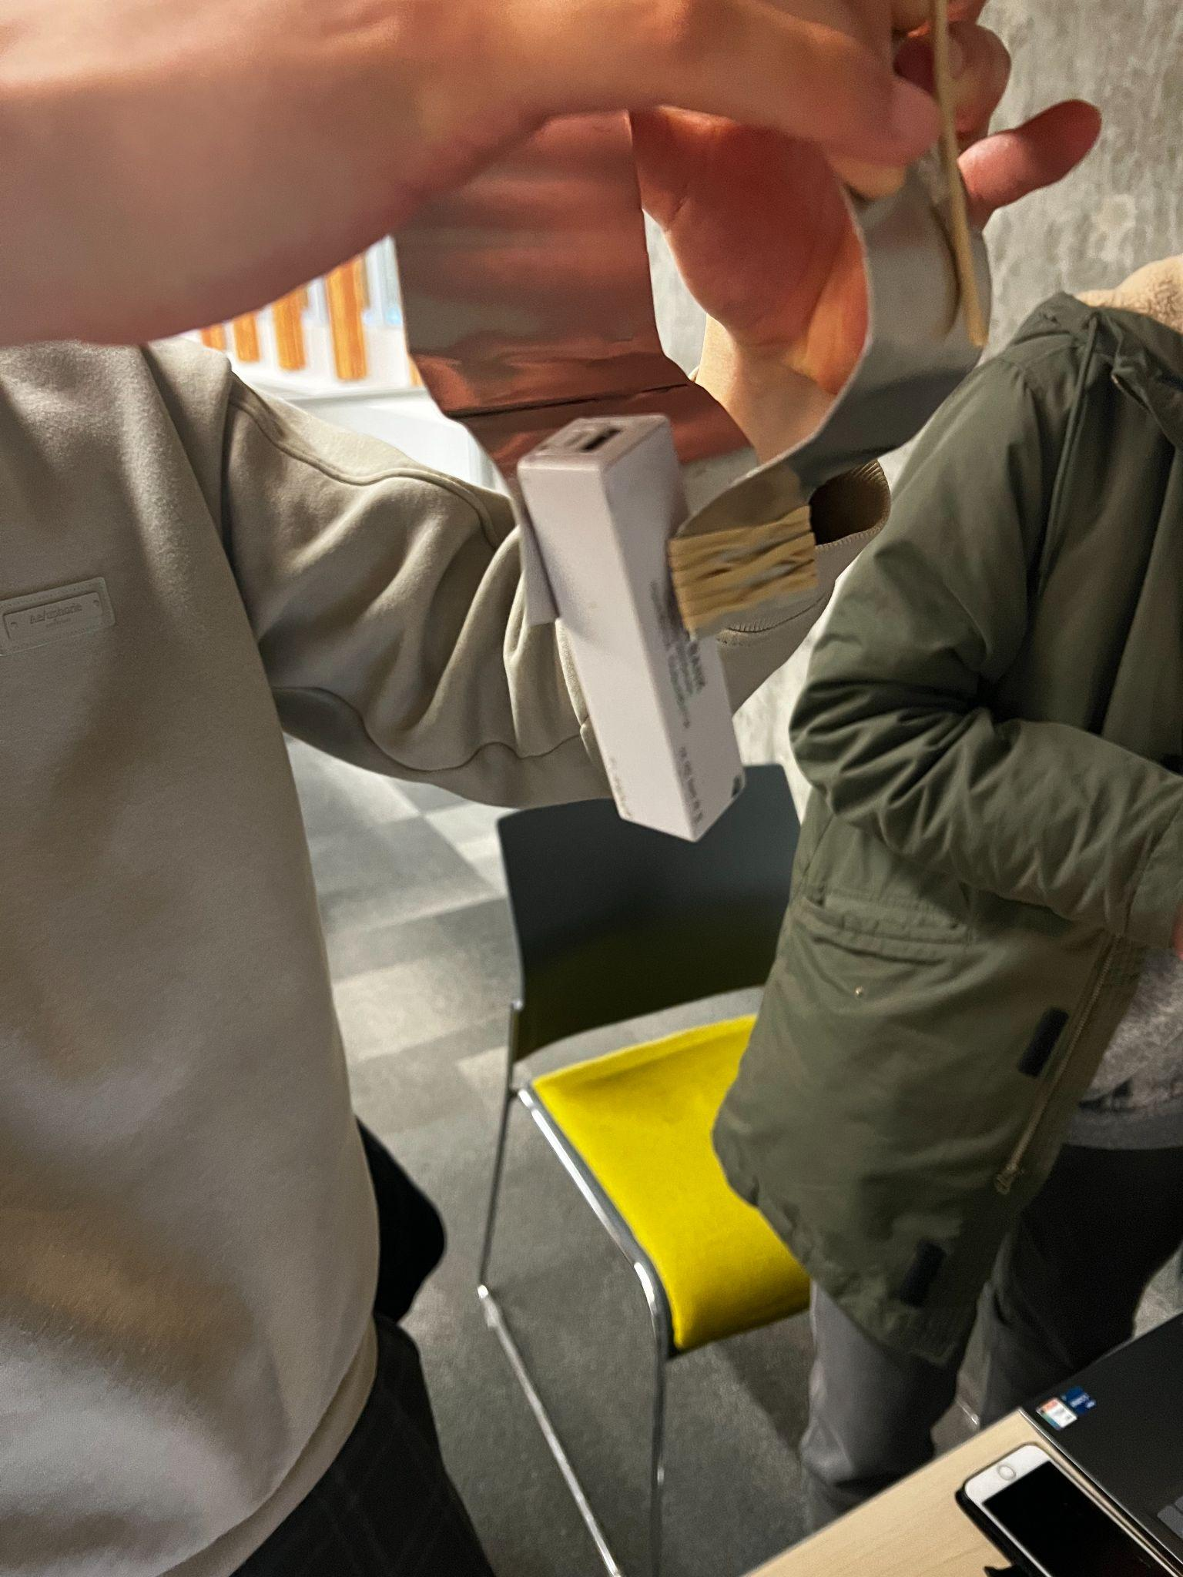
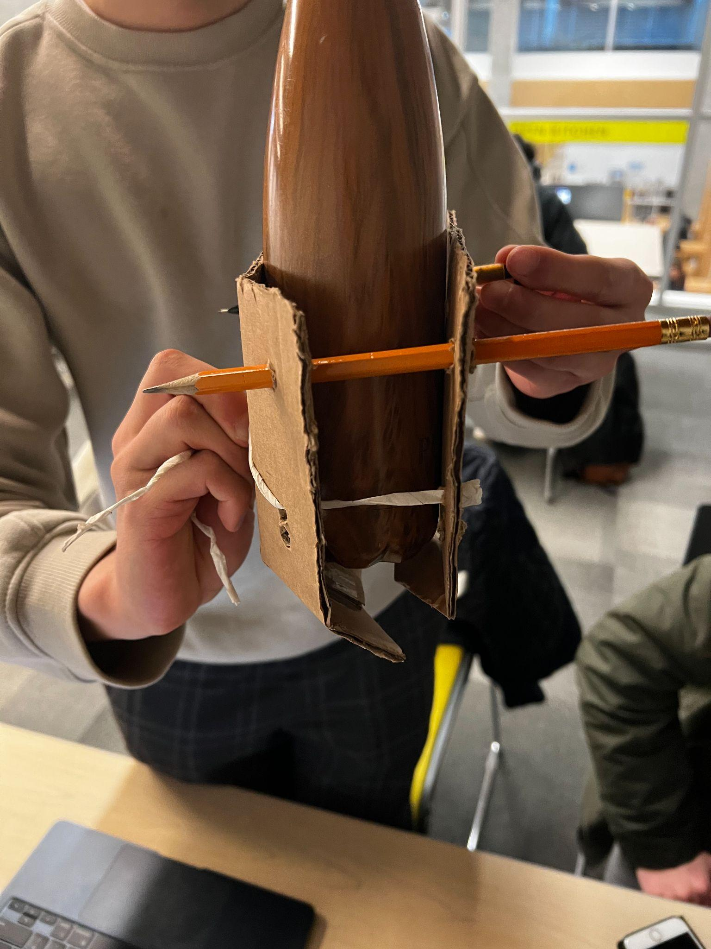
Weight Design Experiment
Risks: The claw cannot hold the weight and breaks during the competition
Solution: Test the limit of the claw before hand to understand what it's capabilities are.

Slide 31
Weight Design Experiment
Trial | Super Scooper | Pincher
#1 | 300 g | 150 g
#2 | 400 g | 100 g
#3 | 300 g | 200 g
Final Average | 333 g | 150 g
Experiment: Took multiple attempts to progressively pick up heavier objects to record its maximum capacity.
Result: The Super Scooper can pick up more weight than the Pincher and it is capable of picking up the heaviest object in the variety round, the can of tomato paste.

Slide 32
Time Delays Consistency Experiment
Risk: Setting time delays for when the claw opens and closes may increase consistency of success in picking up objects as it allows time for the operator to position the claw properly, but also adds the risk of going over the allotted time.
Solution: Determine which timing preset is the most optimal for the sake of the given tasks to improve success rate and efficiency.

Slide 33
Time Delays Consistency Experiment cont.
Experiment: We record the time our claws takes to complete a simulated round and the number of times the claw fails to pick up/drop off an object.
Results: We noticed a time discrepancy between bulkier objects to smaller objects when both claws picked up and dropped objects. The Super Scooper carries large objects in a shorter period due to its large claws, while the Pincher struggles due to its reliance on smaller contact area and friction.

Slide 34
Competition Results Reflection
Successes:
Completed and gained points during both rounds
Claws did not malfunction and performed as expected
Areas for improvement:
Time management during the competition
Communication in agreeing upon who would be directing the crane operator
-Our strategic technical risk of creating 2 claws was beneficial, as we did end up using both claws throughout the competition for the various rounds.
-This module was a vital learning experience for us, teaching us that it would be better to plan out a module at its start, and follow a schedule with checkpoints in order to make sure we reach our goal of completing the deliverable.

Slide 35
Roles and Contributions For E-Poster
Tiger Zhou
Daniel Mok
Ahmad Abousaleh
Competition overview(s)
Intro slides
Design Challenge/Team Strategy
Prototypes
C-Sketches
Strategic Risk Approach
Risk Design Matrix
Screening/Ranking/Scoring
Time Delays Experiment
Engineering Drawing
Competition Reflection
Slide Timings
Final Proof-Read
Yuding Jia
Helin Long
Andrew Wang
Weight Design Experiment
C-Sketches

Slide 36
Thank You!

Slide 37
Appendix

Slide 38
Risk Matrix
Risk | Severity | Likelihood | Rating | Action | Classification
Sensor code does not work properly, so the claw doesn't open/close as desired | 5 | 2 | 10 | Test the code for multiple times to check whether it works well | Technical Preventable
A team member gets injured during construction of claw | 5 | 1 | 5 | Make sure to follow all safety procedures and to wear PPE (safety goggles) | Preventable Safety
A team member is unable to attend the competition (sickness or injury) | 4 | 1 | 4 | Make a plan in order to make sure that any tasks assigned to that member are reallocated | External Project Management
Unable to complete competition tasks within the given time limit | 3 | 4 | 12 | Practice with whole team in EDC leading up to competition, make sure every member understands the plan | Preventable Operational
Battery pack is not fully charged and dies during the competition | 4 | 3 | 12 | Come to the competition prepared with charged battery packs | Preventable Operational
The claw cannot hold the weight and breaks during the competition | 5 | 2 | 10 | Test the limit of the claw beforehand to understand what it's capabilities are. | Preventable Technical
Equipment(arduino) malfunctions | 5 | 1 | 5 | Come to the competition with multiple arduinos and be prepared to replace the broken arduino quickly | External Technical
Time for claw opening/closing mechanism is lengthened in return for a more consistent grabbing motion. | 2 | 3 | 6 | Practice picking up and releasing objects and make sure that it is consistent before the competition | Strategic Technical

Slide 39
Scoring WDM
Criteria | Weights | The Super Scooper | The Pincer | The Threaded Clone
Able to pick up variety of objects | 25% | 8 | 4 | 5
Weight Capacity | 25% | 7 | 4 | 5
Pick up and drop off speed | 10% | 4 | 10 | 3
Accuracy/error margin | 25% | 2 | 7 | 3
# of objects picked up | 15% | 6 | 4 | 4
Total | 100% | 5.55 | 5.35 | 4.15

